Slide 1
Computer Inventory
@ MD Anderson
Rick Dillard, CPPM
Manager, Asset control
MD Anderson Cancer Center
Special Guest
Gary Reddicks
Senior Applications Systems Analyst

Slide 2
In the beginning
Computers purchased by any dept with funds.
No limits on how many computers an employee could have.
No formal commissioning or decommissioning process for IT equip.
Computers being delivered directly to customer (UPS/Fedex)
Commissioned by IT and tagged by Asset Mangement. (multiple steps)
Tagging of IT equip delayed if ever.
Offsite usage required paper form submission.
Stale computer standards.
Scanning of bar coded property tag required for inventory.
Many rogue computers (contractor, vendor, employee owned) etc.
Leased and owned computers tracked in two dbases CEMS/Psoft. Never mirrored each other.

Slide 3

Improvements!!
Senior management buy-in.
Internal communications to announce changes.
Tracked device inventory tag used for non-leased it equip and owned under 5K.
Tagging done during commissioning! (One stop shop!)
Forced compliance.
New policies.
Device quotas.
New device procurement process.
Formal commissioning and decommissioning process.
All leased and owned IT equipment tracked in one dbase CEMS.
One system of record!

Slide 4

Improvements II
No more paper forms for offsite usage.
Access to multiple dbases for inventory hits.
Commissioning process tags and creates asset in the Computer Equipment Management System CEMS.
Evidence of loggin into the network provides support for inventory purposes.
Decommissioning process insures data sanitization.

Slide 5
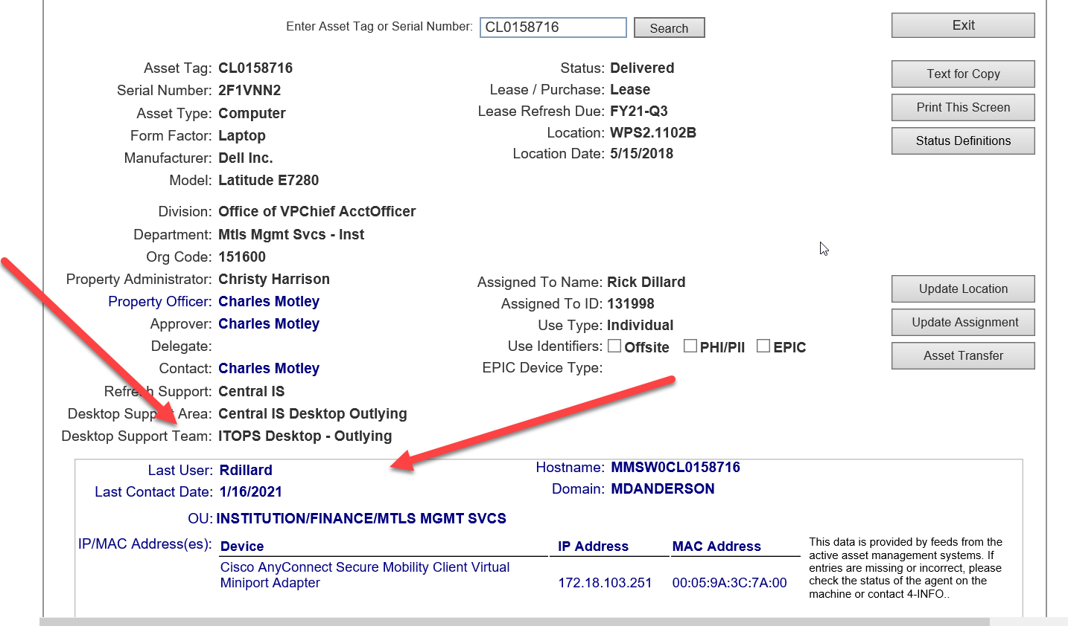

Slide 6
Ask the Archtect!!!!
How do you perform the inventory of computing devices!!!

