Slide 1
Why Does My Ethics Policy Say That?
Jason D. King: Assistant General Counsel and Deputy Ethics Advisor
TASSCUBO
November, 2014

Slide 2
Overview: What You’ll Learn
What is an ethics policy
What’s in an ethics policy
Why its in the policy

Slide 3
What’s an Ethics Policy
Ethics Policies have nothing to do with ethical conduct.
Webster Definition:
rules of behavior based on ideas about what is morally good and bad
Thou Shalt Not…
Notes:
Travel policies tell us how to travel, purchase policies tell us how to purchase, so Ethics policies must tell us how to be ethical right? Nope.
Imagine a purchase policy that doesn’t tell you how to purchase, only how not to purchase.
Strange list of thou shalt nots.

Slide 4
Strange Set of Concerns
Not concerned with:
Efficiency
Productivity
Effectiveness
Reduced costs
Primarily concerned with:
Good intentions
Faith in government
Notes:
As business executives, you’re concerned with efficiency, productivity, effectiveness, reduced costs…
Imagine, you’ve just finished a big deal, but your president is concerned with the intentions of your vendor.

Slide 5
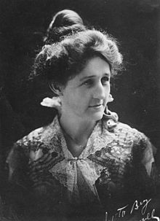
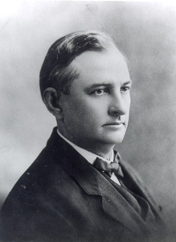
Why have one at all?
Ma and Pa Ferguson
Governor Pa
1915-1917
Governor Ma
1925-1927
1933-1935
Notes:
Tell story of rise and fall of Ma and Pa, and the pardon scandal. Perry 8-35 per year. Ma over 100 per month. According to rumor, state highway contracts only went to companies that advertised in the Fergusons' newspaper, Ferguson Forum

Slide 6
Lessons Learned?
Ethics reform only happens in response to a crisis.
Ethics regulations do not have an overarching goal or organization.
If a public official abuses their authority, it will be curtailed.

Slide 7
What’s in an Ethics Policy
Conflicts of Interest
Gifts and Bribery
Honorarium

Slide 8
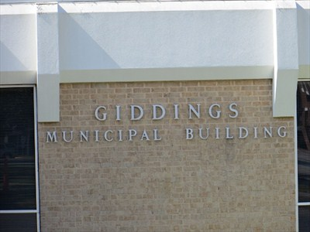
Conflicts of Interest
Notes:
Tell Jim Maddox 1984 JM-171 story. Jail construction. VP of A/C business is city councilman.

Slide 9
Conflicts Continued
Common Law extremely strict
Piecemeal exceptions, no overarching plan
Higher Education Boards gets their own exception (disclose and recuse)

Slide 10
Conflict Continued
Government employees get one too:
Might reasonably tend to influence test; and
Reasonably be expected to impair independence of judgment
Notes:
Actual influence not required (just appearance). Tend to influence? Expected to impair independence?

Slide 11
Gifts Prohibitions
Bribery (36.02 Penal Code)
Doing anything in your official capacity in exchange for anything other than your salary
Applies even if the quid pro quo isn’t explicit
No exceptions

Slide 12
Additional Gift Restriction, 36.08 Penal Code
Asking for or accepting any benefit from someone who has an interest in or is likely to have an interest in the matters under your authority is prohibited.

Slide 13
Exceptions from 36.08
a fee prescribed by law to be received by a public servant or any other benefit to which the public servant is lawfully entitled or for which he gives legitimate consideration in a capacity other than as a public servant;
a gift or other benefit conferred on account of kinship or a personal, professional, or business relationship independent of the official status of the recipient;
a benefit to a public servant required to file a statement under Chapter 572, Government Code, or a report under Title 15, Election Code, that is derived from a function in honor or appreciation of the recipient if:
(A) the benefit and the source of any benefit in excess of $50 is reported in the statement; and
(B) the benefit is used solely to defray the expenses that accrue in the performance of duties or activities in connection with the office which are nonreimbursable by the state or political subdivision;
a political contribution as defined by Title 15, Election Code;
a gift, award, or memento to a member of the legislative or executive branch that is required to be reported under Chapter 305, Government Code;
an item with a value of less than $50, excluding cash or a negotiable instrument as described by Section 3.104, Business & Commerce Code;
an item issued by a governmental entity that allows the use of property or facilities owned, leased, or operated by the governmental entity;
transportation, lodging, and meals described by Section 36.07(b); or
complimentary legal advice or legal services relating to a will, power of attorney, advance directive, or other estate planning document rendered:
(A) to a public servant who is a first responder; and
(B) through a program or clinic that is:
(i) operated by a local bar association or the State Bar of Texas; and
(ii) approved by the head of the agency employing the public servant, if the public servant is employed by an agency.
food, lodging, transportation, or entertainment accepted as a guest and, if the donee is required by law to report those items, reported by the donee in accordance with that law.

Slide 14
The Big Exceptions
Personal, professional, or business relationship independent of the official status of the recipient
An item with a value of less than $50, excluding cash or a negotiable instrument
Food, lodging, transportation, or entertainment accepted as a guest

Slide 15
Honorarium, Section 36.07 Penal Code
A public servant commits an offense if the public servant
solicits, accepts, or agrees to accept an honorarium
in consideration for services that the public servant would not have been requested to provide but for the public servant's official position or duties.
Notes:
Start with what the law is trying the prevent (governor getting himself rich). Historical discussion, rise of the merchant class. Nobility unhappy.

Slide 16
Honorarium, 36.07 Continued
The public official can still accept food, lodging and transportation, so long as the official is performing an actual service at the event.

Slide 17
Key Question
Are you being asked to perform a particular function due to your official position, or due to your expertise?

Slide 18
Questions?

