Slide 1
Strategic Risk Management The Power of Disruption
TASSCUBO 2014 Primary Member’s Retreat
Fort Worth, Texas| November 10, 2014
Kathie Schwerdtfeger
Partner
Strategic Risk Services | Crisis Management
Deloitte & Touche LLP

Slide 2
One day you’re on top of the world…

Slide 3
Paralysis | Denial
Notes:
These are the two most common ways people deal with the experience you may have had.
Paralysis that comes from too many possibilities, or a sense of being overwhelmed without any kind of framework for organizing the experience.
Denial has many forms, from “that’ll never happen,” to the confidence of “I know exactly what will happen.” – The confidence that says I know enough to predict the future.

Slide 4
“They Couldn’t Hit an Elephant at that Distance.”
John Sedgwick May 9, 1864
Notes:
History is littered with stories of smart, well informed leaders who didn’t act, or acted foolishly, in the face of new information.
Not every one was quite as dramatic as this one …. The Union General who while preparing to go into battle at Spotsylvania Virginia, didn’t appreciate the changing technology of rifling at precisely the wrong moment.

Slide 5
“This ‘telephone’ has too many shortcomings to be taken seriously as a means of communication.”
William Orton President Western Union 1876
Notes:
There are those who didn’t take change seriously enough: William Orton, the premier telecommunications executive of his day, who saw no future in the telephone and turned down the offer to buy the patent. He wasn’t the only one…
(Ken Olson (PCs), Kodak (digital photography), Edison (phonograph), AT&T (cellular)) – they could see the technology, but they couldn’t see a world different enough to make those technologies the new normal.

Slide 6
Born that Way
Anchoring / Anthropic bias / Attributional bias / Availability bias / Barnum effect / Base rate neglect / Behavioral confirmation / Belief perseverance / Bias blind spot / Clustering illusion / Confirmation bias / Conjunction fallacy / Contrast effect / Cultural bias/ Dilution effect / Disconfirmation bias / Egocentric bias / Endowment effect / Expectancy effect / Experimenter’s regress / False consensus effect / Framing effect / Fundamental attribution error / Gambler’s fallacy / Group-serving bias / Group attribution error / Halo effect / Hindsight bias / Hostile media effect / Hyperbolic discounting / Illusion of control / Illusion of validity / Illusory correlation / Impact bias / Infrastructure bias / In-group bias / Just-world phenomenon / Kuleshove effect / Lake Wobegon effect / Logical fallacy / Loss aversion / Media bias / Memory bias / Mere exposure effect / Misinformation effect / Negativity effect / Negative perception of the color black / Notational bias / Out-group homogeneity bias / Overconfidence bias / Pathetic fallacy / Peak-end rule / Physical attractiveness stereotype / Planning fallacy / Picture superiority effect / Positivity effect / Preference reversal / Primacy effect / Priming / Projection bias / Pseudocertainty effect / Pseudo-opinion / Publication bias Recency effect / Regression fallacy / Reporting bias / Risk-aversion / Rosy retrospection Sample bias / Selection bias / Selective perception / Self-deception / Self-serving bias / Spacing effect / Statistical bias / Status quo bias / Sunk cost effects / Tunnel vision / Trait ascription bias / Valence effect / Von Restorff effect / Wishful thinking / Worse-than-average effect / Zeigarnik effect
Notes:
Our own minds trick us, and they do it in what we increasingly understand to be entirely predictable ways. (cf. Dan Ariely’s “Predictably Irrational.”) This is a partial list of cognitive biases –normal and predictable ways we misperceive and make mistakes about the world around us. Here’s a few that may be at work in people you know…
Availability: the tendency to overestimate the likelihood of events with greater "availability" in memory, which can be influenced by how recent the memories are or how unusual or emotionally charged they may be.
Confirmation: the tendency to search for, interpret and remember information in a way that confirms one's preconceptions
Hindsight: the tendency to see past events as being predictable at the time those events happened.
Overconfidence: excessive confidence in one's own answers to questions. (inability to calibrate)
Projection: People exaggerate the degree to which their future tastes will resemble their current tastes.
Selective Perception: the tendency for expectations to affect perception

Slide 7
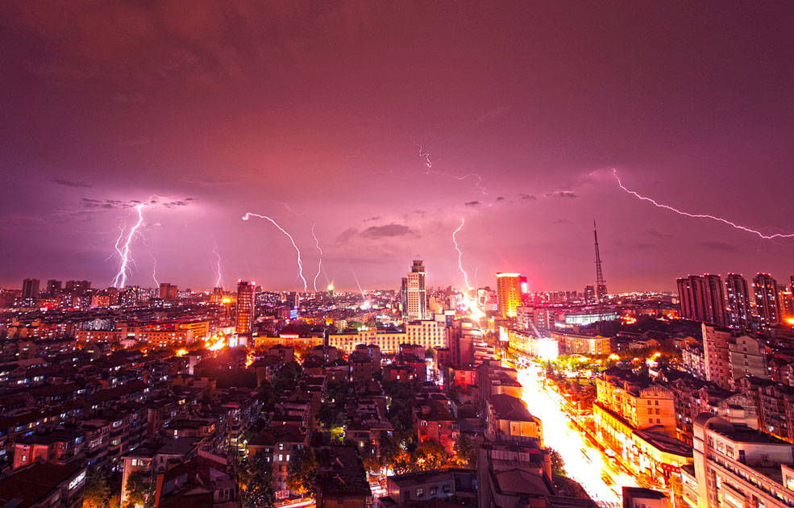
A VUCA World
Notes:
We live in a world the US Army War College has dubbed VUCA – Volatile, Uncertain, Complex, and Ambiguous. In business the VUCA world is the culmination of 50 years of movement from an industrial to an information economy.
It’s the result of everything from automation to outsourcing, deregulations to globalization, personal computing to the internet. These changes have vastly improved productivity and connectivity, paving the way for tremendous business innovations and consumer benefits.
But there’s a flip side to this progress. In the VUCA world organizations face increasing demands from customers they’ve never served with needs they’ve never had to meet, relentless pressures thanks to competitors with lower costs, and business model threats from upstarts in new sectors. Throw in macro trends like social, mobile, and cloud based technologies as the ever changing demographics of customers and employees. If this was not enough, a 24/7 feedback culture allows customers and employees to vilify organizations and damage their reputation through social media in a matter of minutes and hours.
The challenge is how to anticipate, adapt, maneuver, make decisions, and change course as needed in a VUCA world.

Slide 8
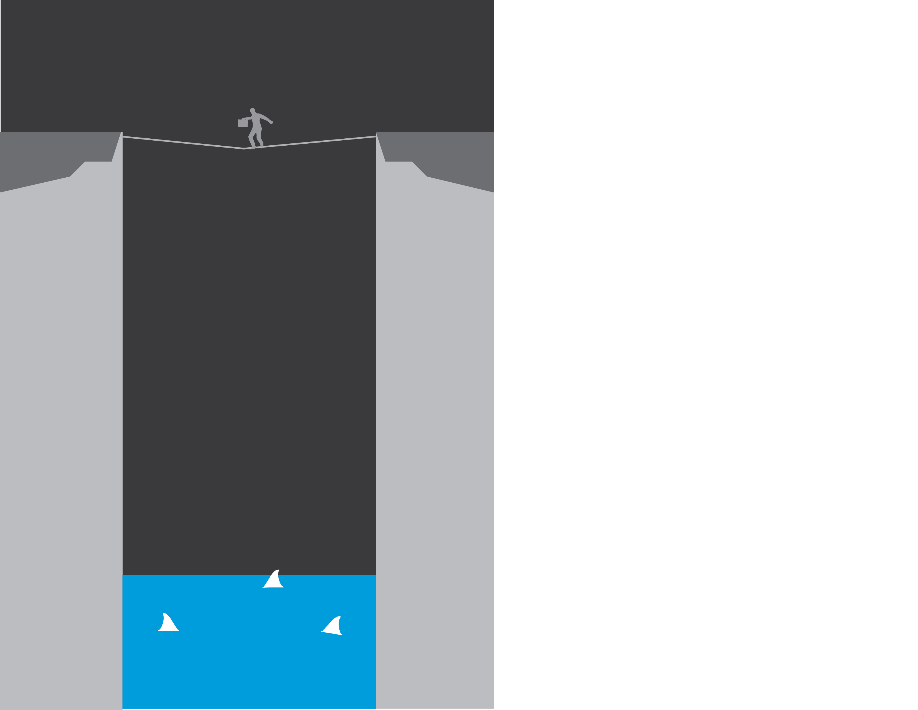
Risk Is Not a Game
Notes:
The only way to respond is by changing your approach to risk.
Because of the complex world in which our organizations now operate, strategic risk has earned a rightful position at the top of the executive agenda.
Boards want to know that the executive team is “ON IT” and CEO’s want to be sure they’re not “MISSING IT”.

Slide 9
Strategic risks are that ones that threaten to disrupt the assumptions at the core of the organization’s strategy
Spotted early and handled well, they can be the basis for game-changing moves that reorder the expected
Strategic Risk Management | The Power of Disruption
Notes:
Spotting and responding to this special category of risks is unfamiliar territory.
Not every risk is a strategic risk.
Strategic risk threaten to destroy value creation.
Often no historical perspective to draw from to assess potential nature and impact.
Strategic risks cannot be managed in traditional ways—ERM, GRC, SOX.

Slide 10
Why is it so challenging?
Unclear what to look for
Signals often weak
Sources may be in other industries or geographies
No historical precedent
Traditional tools and methods don’t reliably detect what’s “over the horizon”
Strategic Risk Management | The Power of Disruption
Notes:
Why is it so challenging to define, identify, and manage strategic risks?
Not clear what to look for
Signals may be weak until its too late
Sources of SR may be in other industries or geographies
No historical precedent
Methods/Tools don’t reliably capture or track them; designed for other important risks

Slide 11
What smart organizations will do
Strategic Risk Management | The Power of Disruption
Notes:
Fortunately the tools to help companies thrive in a VUCA world do exist.
Smart organizations will develop a system to deal with unexpected change.
Accelerate pace at which they discover source of surprises.
Scan continuously--search for the tipping point, disruptive change may start with small changes
Confront your biases--admit your biases and step out of yourself to observe them at work; Invite your most vocal critics in.
Prepare for surprises--respond with confidence, clarity, and precision—rehearse readiness

Slide 12
Putting it into practice
Discover
Scan
Prepare
Strategic Risk Management | The Power of Disruption
Notes:
Preparing for strategic risk may not yet be on your performance evaluation but as a senior executive YOUR CERTAINLY ON THE HOOK FOR IT.
Discover. Scan. Confront. Prepare. Dot it with the best knowledge you can find—about the world, yourself, and your team.
Get ready—doing nothing could be the deadliest strategic risk of all.

Slide 13
Discover
Simulations
Scenario Planning
Discover
Research
Scan
Prepare
Strategic Risk Management | The Power of Disruption
Notes:
To go one step deeper:
Discover: Through a combination of analytical, behavioral science and foresight tools identify the strategic risks that attack the basis for competitive advantage, challenge the logic of an organization’s strategic choices, threaten it’s competitive position, and undermine its ability to achieve or maintain exceptional performance.

Slide 14
Prepare
Identify New Strategic Options
Discover
Strengthen Roles, Systems & Governance
Scan
Prepare
Contingencies & Hedges
War-gaming
Strategic Risk Management | The Power of Disruption
Notes:
Prepare: Leverage existing tools to help establish risk ownership, reporting and governance procedures.

Slide 15
Scan
Discover
Monitor
Define
Interpret
Scan
Prepare
Strategic Risk Management | The Power of Disruption
Notes:
Scan: Engages a combination of technological and human analyst activities to systematically identify data that provides a clear, 360-degree picture of developments in the organization’s domain. Raw data is prioritize, synthesized, and analyzed to generate insights relevant to the organization’s strategy.

Slide 16
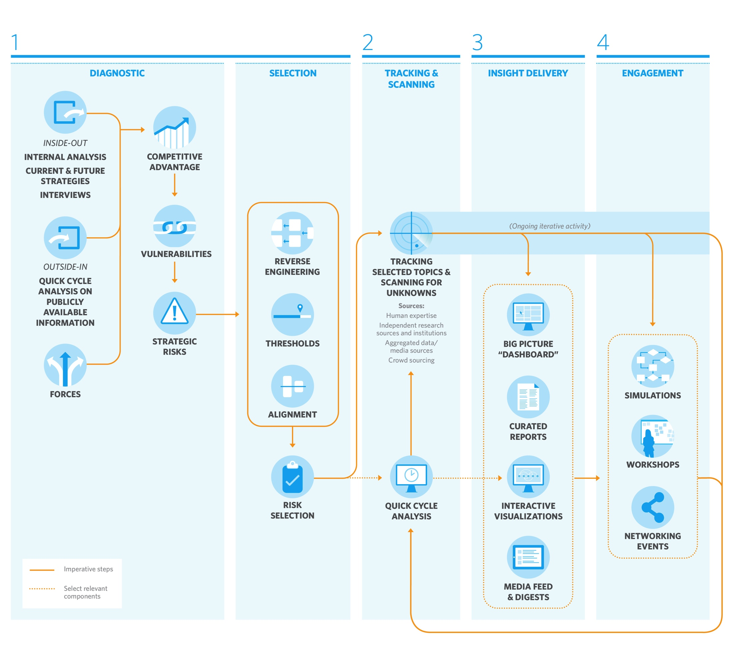
Putting it all together-An end-to-end system
Notes:
A systematic response to strategic risk can help mitigate traditional organizational constraints such as poor communication, bureaucracy, busyness, group think, and reactive governance.
Putting it all together in a well designed end to end system helps leading organizations better anticipate, respond, and thrive in the face of disruption.

Slide 17
Headline is intentionally off of the slide, as it isn’t used. First
“The task is not so much to see what no one has yet seen, but to think what nobody has yet thought about that which everybody sees.”
Arthur Schopenhauer
Notes:
Because that’s what will close the loop between what’s possible tomorrow and what we need to do today. As I said before, in the face of an amazing array of possibilities, how will any of us make choices, with conviction, about how to prepare? How can we pull out what is relevant, even critical, for our future, when technologies are changing so quickly, social trends come and go, law and regulation here and abroad can surprise us?
Fortunately, there is lots of information, once you know where to look, about what could shape the future.
I suggest the work that remains is not to see what no one else can see, but to think what no one else in your field is thinking about what it means and how you’ll prepare. In strategy, in innovation, and in the development of your people. We know these technologies and trends will shape the world; what it will mean, and what you can do about it, is the challenge that lies ahead.
Good luck! And thank you very much.

Slide 18
Questions?

Slide 19
As used in this document, “Deloitte” means Deloitte & Touche LLP, a subsidiary of Deloitte LLP. Please see www.deloitte.com/us/about for a detailed description of the legal structure of Deloitte LLP and its subsidiaries. Certain services may not be available to attest clients under the rules and regulations of public accounting.
Copyright © 2014 Deloitte Development LLC. All rights reserved.
Member of Deloitte Touche Tohmatsu Limited

