Slide 1


Emerging and Strategic Risk Management
TASSCUBO
Janice M. Abraham, President & CEO

Slide 2
Strategic Risk Management
  A collaborative process, led by senior leadership, that expands the core concepts of risk management:
  Identifying risks across the enterprise
  Assessing the impact of the risks to the plans and mission
  Developing and testing mitigation plans
  Monitoring identified risks and consistently scanning for emerging risks

Slide 3
Best Practices
Tone at the top matters: Champions are essential
Understand and embrace specific roles
Build on the work of others; use Risk Registers
Question sacred cows

Slide 4
University A
Risk Register:
Adequacy of financial resources
Information technology infrastructure, systems and support
Age and condition of facilities and physical plant infrastructure
Recruitment and retention of top personnel
Individual and institutional conflict of interest, employee misconduct, regulatory non-compliance
Execution of Strategic Plan

Slide 5
University B
Risk Register:
Governance
Student enrollment
Liquidity, debt and reserves
Health care costs
Management turnover
Return on investment in new capital projects and programs
Legal/regulatory compliance
Information security
Disaster recovery and business continuity
Potential for fraud and conflicts of interest

Slide 6
University C
Risk Register:
Strategic Plan implementation
Income diversification
New initiatives: Research, Accreditation
Governance
Faculty: Demographics
Compliance: Research, Title IX, Clery
Athletics: Compliance, funding, injuries

Slide 7
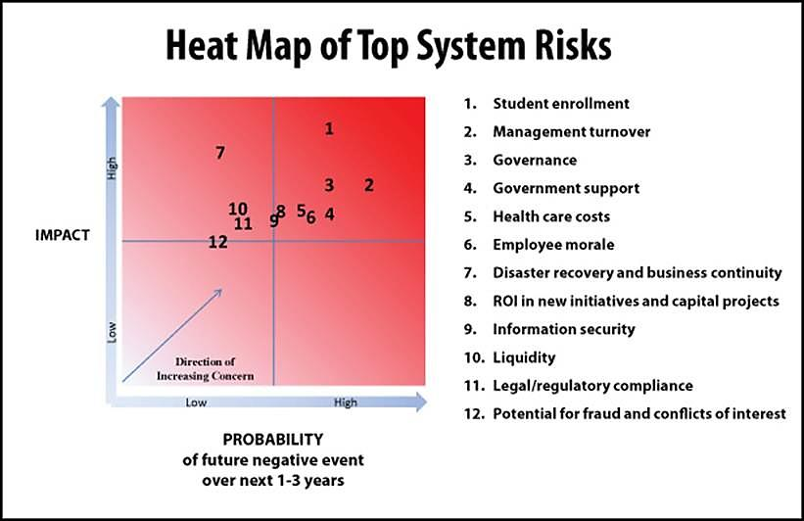
University B
Risk Assessment:

Slide 8
Strategic
Crisis response and Business Continuity Plan
Information Technology
Reputation and Brand
Strategic Planning

Slide 9
Finance & Land Use
Income diversification
Debt
Conflict of interest
Campus master plan
Deferred maintenance and life safety
Space utilization
Total cost of capital projects

Slide 10
Audit
Compliance
  Centralized or decentralized strategy
Coordination of audit plan and gap analysis
Whistle blower, fraud and reporting

Slide 11
Academic Affairs
Accreditation: New and ongoing programs
Blended learning strategy
Entrepreneurial ventures
Faculty; recruitment, tenure, development
Global strategy

Slide 12
Campus Life
Admissions, Enrollment, Retention
Alcohol and drug use
Athletics
  Academic Integrity
  Injuries
Campus safety and security: Clery Act, VAWA
Sexual Assault/Title IX
Experiential Learning
Financial aid/Student debt
Student Health Center and Mental Health
  Virus response plan

Slide 13
Research
Intellectual property
Conflicts of interest
Financial sustainability
Incubator support

Slide 14
Development/Foundation
Gift acceptance and use policy and procedures
Comprehensive campaign support

Slide 15
Lessons Learned
From Others
Focus on high-impact risks
Focus on mitigation plans
Take on the tough issues and sacred cows
All risks must have owners
It’s a process and business tool, not a project

Slide 16





Stay Connected
Janice Abraham
President & CEO
Prevention and Protection for EducationTM
7700 Wisconsin Avenue, Suite 500
Bethesda, MD 20814
Office: (301) 907-4908
Direct: (301) 215-8462
jabraham@ue.org
bit.ly/UELinkedIn
@UnitedEducators
bit.ly/UEYouTube

