Slide 1
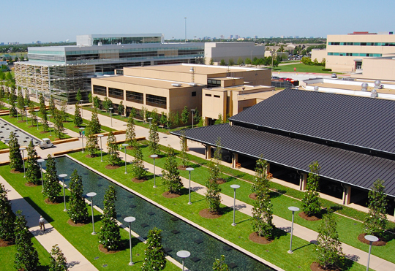
TASSCUBO Process Redesign (Lean) at Universities Panel Discussion
Moderator - Calvin D. Jamison, Ed.D Vice President for Administration The University of Texas at Dallas

Slide 2
What is Process Redesign (Lean)?
Lean is NOT a method to eliminate positions
Lean IS a method to streamline processes where employees can work more efficiently and produce quality results.
Lean is about CULTURE!
A systematic approach to identifying and eliminating waste (non-value added activities) through continuous improvement by flowing the product at the pull of the customer in pursuit of perfection.
National Institute of Standard Technology (NIST)

Slide 3
Foundation of Process Redesign (Lean)
A holistic approach to streamline the way the university conducts its business (including outsources)
Aimed at making the university a cost efficient organization
Delivers improved services to students, faculty and staff.
Identifies & removes process inefficiencies to make the university more responsive, flexible and efficient.

Slide 4
Process Redesign (LEAN) and Service Excellence Culture at UT Dallas
Continuous Evaluation
Continuous Improvement
Continuous Feedback
LEAN at UT Dallas
Identifies Improvement Areas
Removes Waste in Time, Motion and Money
Removes Non Value-Added Activity
Fills Gaps in Purpose, Process and Performance
LEAN Means Constantly Striving for Excellence
Improving the Quality of What We Do
Making a Habit–Not an Act–of Finding Ways to Streamline Processes
Notes:
LEAN Initiative and Service Excellence Culture
LEAN at UT Dallas
Elimination of waste or non value-added activities from a process in order to improve efficiencies and provide quality customer service.
Identifies Improvement Areas.
Removes Waste in Time, Motion and Money.
Removes Non Value-Added Activity.
Fills Gaps in Purpose, Process and Performance.
LEAN entails constantly striving for excellence by:
Improving the quality of what we do.
Making a habit, not an act, of finding ways to streamline processes.
Continuous Evaluation -> Continuous Improvement –> Continuous Feedback ->

Slide 5
Panelists
BJ Crain, Vice President for Finance & CFO Texas A&M University
Mary Knight, Associate Vice President The University of Texas at Austin
Julie Grant, Assistance Vice President, Business Operations Yale University

Slide 6
TASSCUBO Process Redesign at Universities – Panel Discussion
Process Improvements
B.J. Crain
Vice President for Finance and CFO
Texas A&M University
July 22, 2013

Slide 7
Process Improvement
A&M System - Shared Services Initiative
Before-Now-Future
Texas A&M - Review and Improvements
Shared services with other A&M system members
Mandatory ACH refund policy
No-cash payment policy for tuition and fees
Enhanced financial monitoring –auxiliary enterprises
Unclaimed property software
Changed criminal background check vendor
Outsourcing
University Advancement Fee
Course Fees
Notes:
Shared services with other TAMU system members
Financial services – TAMU System Office and Galveston
HR services (benefits and/or software for recruitment, position management, and performance management – TAMU System Offices, Galveston, Commerce, Texarkana
Training services – all system members
Implemented a mandatory ACH refund policy
Reduces cost of refund processing
Eliminates the difficult and costly process associated with unclaimed student refund checks including both returning funds to Dept of Education and reporting unclaimed funds to the State.
Students get their funds much faster
Received minimal negative response from customers
Implemented a “no-cash payment policy” for tuition and fees
Require students to pay online, utilize lockboxes/drop boxes, accept check payments in person.
If student brings in cash to pay, we require them to go to bank to get cashiers check.
Able to reallocate staff to other areas to better meet the needs of our students and parents\
Received minimal negative response from customers
Enhance financial monitoring of auxiliary enterprises
In conjunction with auxiliary departments, the Division of Finance now creates monthly full accrual financial statements for all auxiliary enterprises.
Auxiliary departments and Division of Finance provide quarterly analysis on all auxiliary activities to CFO.
Perform reconciliations of all monthly financial reports to the general ledger.
Implemented Unclaimed Property software
Automates process of reporting unclaimed property to States.
Built in rules and requirements for each state’s unclaimed property reporting.
Greatly reduced amount of time the accounting group spends on handling unclaimed property.
Implemented Concur Travel and Expenses Reimbursement software
End-to-end travel solution – from travel booking through the expense reimbursement.
Implemented April 2012
Eliminates paper intensive process.
Travel booking module is not mandatory.
All travel reimbursements must go through Concur
Have full record of where employees are traveling
Use data to negotiate discounted rates with airlines, hotels, etc.
Implementation encountered some problems
Departments changing processes that put more work on the traveler
Changed criminal background check vendor
24/7 Secure, online access for candidates to enter their information (i.e.; SSN)
Candidates automatically receive all required initial notices by the online access and can also select to obtain a copy of their report.
Search is more comprehensive
Any further action taken on the candidate (such as reviewing a hit and documenting what action was taken) is all online in the candidate's record as opposed to being kept by paper copy.
Better metrics on process timelines. (i.e. when candidate completed information online, how long search took to complete

Slide 8
Division of Finance Performance Excellence Management Model (PEMM)
Measurement, Analysis and Knowledge Management
Notes:
The Division of Finance began it’s continuous improvement initiative in January of 2008.
The division’s Performance Excellence Management Model or PEMM includes the following performance categories –
Leadership
Strategic Planning
Customer and Client Focus
Employee Focus
Process Management
Outcomes
And all these categories are underscored by Measurement, Analysis and Knowledge Management.
Our focus today is on the process management categories and includes the continuous review cycle of Plan Do Check Act using one or more of the appropriate continuous improvement process review tools – process mapping, root cause analysis, cause and effect diagram, Pareto charts, histograms, etc.

Slide 9
TASSCUBO Process Redesign at Universities – Panel Discussion Shared Services
Mary Knight Associate Vice President The University of Texas at Austin July 22, 2013

Slide 10
The University of Texas at Austin Business Productivity Committee
In April 2012, President William Powers Jr. appointed 13 business leaders to form the Committee on Business Productivity to examine ways in which The University of Texas at Austin might increase its operational efficiency
and productivity.

Slide 11
The University of Texas at Austin Business Productivity - Administrative Systems Transformation Subcommittee
Studied how UT Austin could save by changing how a number of administrative functions are organized and operated.
–This “shared services” initiative would consolidate certain functions within finance and procurement, human resources, and information technology.
–Though some consolidation has occurred in these areas over recent years, the committee found that the campus is still highly decentralized across the various colleges, schools, and units in comparison to the best practices of the private sector.
–Consolidating these administrative functions

Slide 12
Shared Services Definition
The practice of aggregating like-kind administrative responsibilities and insourcing them to an internal organization, often a newly constituted service center of people providing like-kind service, to improve operations and reduce cost.
The insourced service organization is managed by University employees. The delivery and quality of the service is managed by a representative governance structure and by service level agreements between the delivering and receiving organizations.

Slide 13
Shared Services vs. Centralized vs. Distributed
Shared Services is a way of organizing service delivery to optimize the delivery of cost-effective, flexible, reliable services to customers.
Centralized Model
Centralized control
Focus on consolidation
Cost-driven
Shared Services
Shared control
Balances responsiveness & efficiency
Service level-driven
Centralized Model
Shared
Services
Model
Scale & Efficiency
Distributed Model
Distributed Model
Distributed control
Focus on responsiveness
Location-driven
Service / Responsiveness
Notes:
Mary

Slide 14
Benefits of Shared Services
Shared services allow organizations to increase focus and results in their core business functions (teaching and research in Higher Education).
Financial Benefits
Labor related savings from economies of scale
Non-labor Savings (e.g., procurement spend, real estate)
Reduce Risk/Improve Compliance
Clear accountability (e.g., service level agreements)
Simplified audits (e.g., through enabling technology)
Increased control & visibility (e.g., standard reporting)
Benefits
Customer
Benefits
Faster transaction response time (e.g., shorter cycle-times)
Responsiveness (e.g., calls/email tracked & answered)
Fewer errors (e.g., standard processes)
Employee Benefits
Better career options (e.g., in new org)
More autonomy (e.g., less supervisors per employee)
High-performance culture (i.e., metrics driven)
Notes:
Mary

Slide 15
Shared Services and Higher Education
Shared services has delivered strong business results in the private sector for over 20 years and is now starting to deliver similar results in Higher Education.
Yale University
Indiana University
Shared services for Finance, HR, Grants Management
3 distinct shared service centers
Services provided across colleges, schools and units
Shared services serve both faculty and staff
HR became operational in 2009, Finance in 2010, Grants Management in 2011
Shared services for Bursar, Registrar, Admissions, Financial Aid, and IT
Serves students, faculty, and staff across colleges and units for 8 regional universities
Implementation is in progress through 2014
Michigan University
New York University
Shared services for Finance and HR
One shared service center that will serve faculty, staff and students (as appropriate)
Implementation phase began in January 2013 – expected to become operational in Q2 2014
PeopleLink provides the NYU Community with accurate and consistent answers to questions
Scope: Benefits, Employee Events, Employee Data, Compensation, Payroll & Time
Highly trained Service Representatives research and resolve inquiries at the first point of contact
Notes:
Mary

Slide 16
The University of Texas at Austin Shared Services Planning Project
The Shared Services Planning Project is the first step in advancing one of the recommendations from the Business Productivity Final Report, “implement a shared administrative services model.” Its objectives are:
Define the service delivery model for Shared Administrative Services
Design the future-state operating model for Finance, Procurement, Human Resources and Information Technology
Develop the change management strategy

Slide 17
The University of Texas at Austin Shared Services – Timeline
Business
Shared
Shared
Shared
Shared
Productivity
Services
Services Plan
Services
Services
Committee
Planning
Dialogue
Implementation
Operations
May-Dec. 2012
April-Sept. 2013
Sept.-Dec.2013
1-4 years
Ongoing

Slide 18
Shared Services: Finance, Procurement, HR, Payroll
Timeline – May to September
Functions in scope: Financial transactions, reconciliations, travel and entertainment, collections, procurement, requisition, accounts receivable, HR functions
Key activities
Current Activity: Information gathering and identification of services to include in the shared services model
Identify specific processes to include
Specify how the shared service organization will be structured
Define service level agreements and other measurements

Slide 19
Shared Services: IT Workstream
Timeline – May to September
Functions in scope: End user support, application maintenance, application development, infrastructure maintenance, infrastructure development
Key activities
Current Activity: Information gathering and identification of services to include in the shared services model
Identify specific processes to include
Specify how the shared service organization will be structured
Define service level agreements and other measurements

Slide 20
Shared Services Steering Committee
The Shared Services Steering Committee includes representatives from the Deans, Faculty, Staff Council, Administration, College Business Officers, and UT System .
The committee charge is as follows:
Provide advisement, directional guidance and feedback to the project team throughout the planning process for the build and implementation of the shared services operating model;
Represent the interests and concerns of your college, school or unit faculty, staff, students and peers; and
Represent the project team to the larger University of Texas at Austin community.

Slide 21
Shared Services Subcommittees
The Shared Services subcommittees will be made up of representatives from each of the areas affected in the transformation: Human Resource Services, Payroll, Finance, Procurement and Information Technology Services (ITS). Preliminary plans are to establish four subcommittees related to the three shared service functions identified by the Business Productivity Committee. Customer Service will be a primary focus.
Human Resources/Payroll
Finance/Procurement
Information Technology (IT)
Customer Services, including Service Level Agreements

Slide 22
Administrative Systems/Technology Improvements
(Concurrent Project with Shared Services)
Initiatives
Improve Design & Management of Data
Design & Build an Open Systems Tech Environment
Adopt Common Software Development Methodology
Administrative Systems Replacement

Slide 23
Transforming UT: Business Productivity Initiative: http://www.utexas.edu/transforming-ut
UT Austin Website

Slide 24
TASSCUBO Process Redesign at Universities – Panel Discussion
Yale Business Services Delivery
Julie Grant
Assistant Vice President, Business Operations
Yale University
July 22, 2013

Slide 25
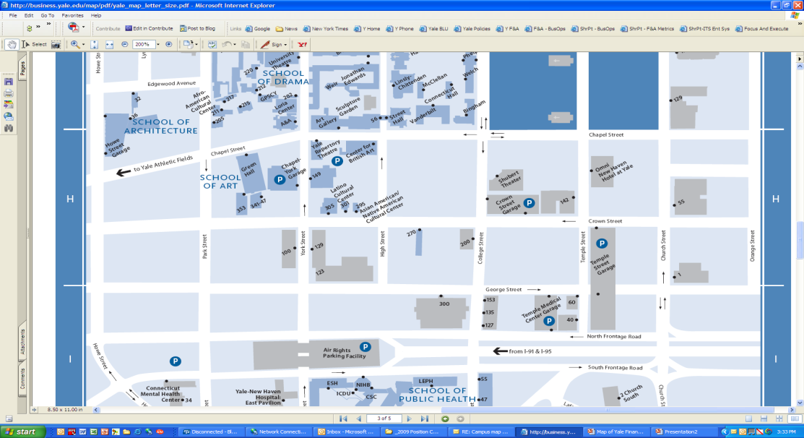
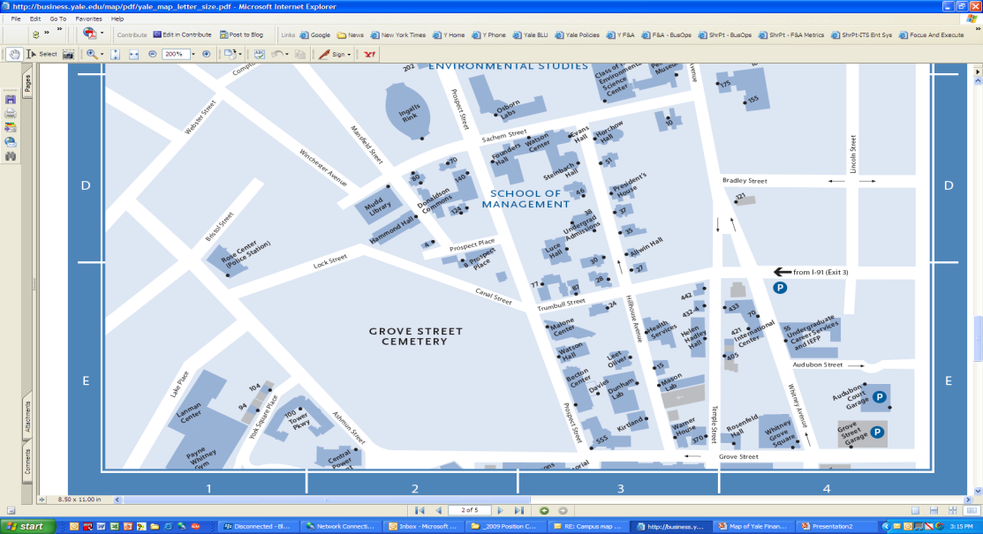
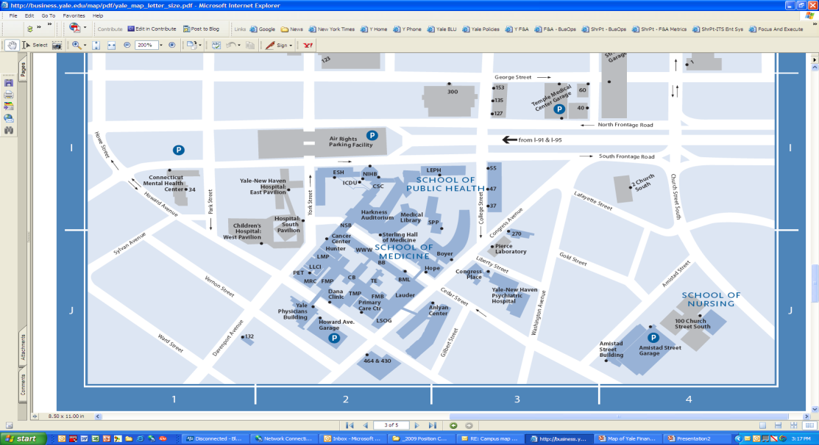
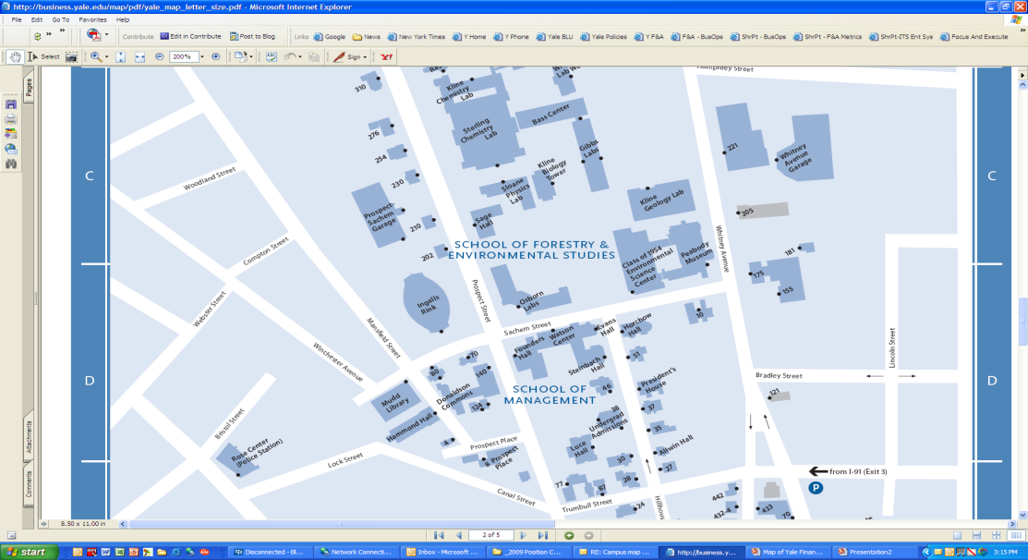
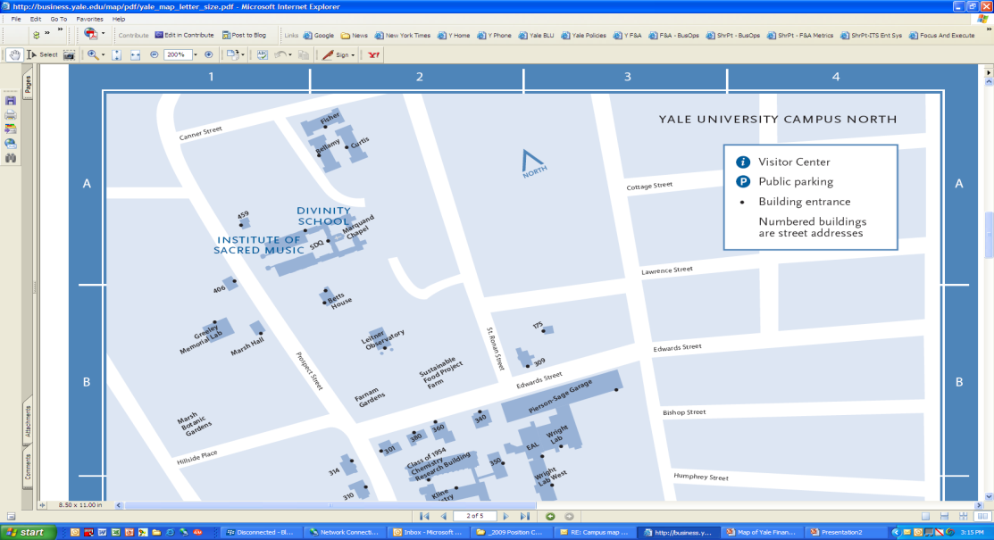
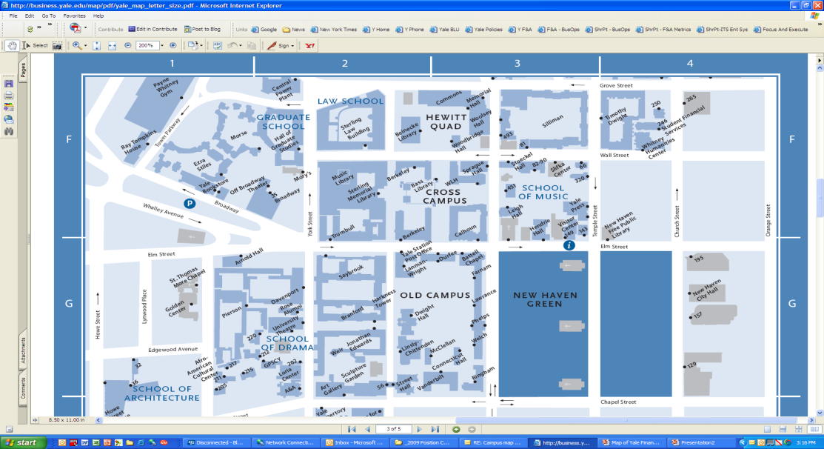
Yale University
Business Manager Positions
28
Ath
28
SBC
MU
Off
28
W Cmp
25
POL
E
AS
E
SLL
24
ISM
28
YAG
25
Art
MCA
E
THS
24
HST
E
EAL
26
YDS
BDS
28
MNEURI
MU
Arch
ME
HAR
26
Drama
22
AYA
28
Grad
FEL
E
NEL
22
YR
22
WOR
29
MORTHO
MNSURG
27
MLMED
28
MDERM
30
MPEDI
27
GLO
29
MDRAD
MIRC
29
MTRAD
30
MCCC
MU
MYSM
MU
Lib
C
BOS
Eliz
27
YLS
27
MCMED
MYARC
00
MOBGYN
28
MOPHTH
27
MPHARM
27
MNBIO
27
CBA
MU
YLS
27
FES
27
MIMMU
29
MANES
30
MSURG
27
MCMPHY
MU
MCELL
28
MCSC
28
MGEN
22
PSI
22
SOC
MU
FES
27
PHY
28
CHM
25
MIMED
Endo
29
MPATH
22
ENG
27
Bein
27
SOM
25
MIMED
Pul
26
MIMED
DD
24
MMPATH
31
MPSY
MYBH
30
MCLIN
20
PHL
MI
Pres
MU
Sec
27
Mac
ERM
MU
SOM
24
EEB
28
MCDB
MI
AST
26
MIMED
Nep
27
SP
20
CLS
E
CLT
D
GRM
24
EPE
ISP
27
CSI
LNG
27
SSSB
MU
S&T
28
MB&B
MI
MYSM
MU
MedCen
27
MFDO
31
MIMED
30
MEPH
26
EHS
D
JUD
21
REL
21
MUS
MU
Music
22
MST
23
MTH
22
STA
24
ECO
22
Cow
23
IBS
26
MIMED
Admin
26
MIMED
Cardio
25
MIMED
GM
E
FRN
E
ITL
E
AAS
27
PSY
28
EAS
30
HSC
23
Growth
22
ISS
26
PM
24
GG
22
HKC
E
SPP
MU
OAS
PU
FCT
25
CMI
24
ATH
ARC
MU
YPress
23
CLS
28
NH
28
CR
23
AMT
E
FMS
30
Facil
MU
BOLT
30
HR
26
PPS
E
REN
MDS
D
LAM
WFF
21
WHC
31
SFAS
MU
GenCl
MU
Invest
30
College
MI
YSN
MU
Dev
23
IR
MU
FAS
Last updated: January 21, 2009
File name: Map of BM Positions v1.ppt
Notes:
This was the map of business managers in 2007. There were 141 in total and the scope ranged from $5,000 budget to $200 million budget.
Additionally, these business managers did not have a reporting line to the CFO.

Slide 26
Business Operations Teams
Notes:
First, we needed to create a reporting line.
We have 6 senior directors that are responsible for the entire campus.

Slide 27
Clarifying Business Positions
70 Lead Administrators
Focus on strategic
Multiple units create expanded scope
139 business managers
53 Operations Managers
Focus on operations
Often regional
Point person for faculty and other departmental people
16 Administrative Coordinators
Union administrative position focuses on local support
Notes:
Then we needed to clarify the roles of the business managers so we could start working on the overall structure of business services support.
The lead administrators are high level strategic partners that have large scopes of responsibility. There is now a threshold for having an on-sight lead administrator.
Operations managers may have multiple departments or they may have responsibility for one very large and complex department.

Slide 28
Lead Administrator Roles
Strategic Partner
University Citizen
Financial Analyst and Advisor
Risk Management Administrator
Administrative Services Leader
Talent Manager and Developer
In process:
Change Leader
Notes:
The lead administrator position became key, as it is the strategic partner of the academic/program leader and the person responsible for high quality business support in the unit(s).
The administrative services leader role includes transformation to the new business services delivery model.
Expanded scope for the most talented lead administrators provides incentive to work toward the new model, as there will be increased opportunity for growth.
Lead administrator is key to influencing the academic/program leader to embrace the new business services delivery model.

Slide 29
Business and Academic Support Model
University Registrar
Lead Administrator
Partnership Agreements
Yale Shared Services
University-wide Support
Business Services
EMS preparation and compliance reviews
AP invoice processing
Monthly financial review and budget support
Accounting Transactions
ISP Billing
Employee Services
Inquiries
Employee data maintenance
Benefits
Pension/Retirees
Grant Services
Pre-award
Post-award
Compliance
Faculty Administration
Recruitments
Appointments
Promotions
Retirements
Budget accountability
Controls oversight
Regional Academic Support Academic Support Coordinator
Regional Business Support
Operations Manager
Acad support standards
DUS, DGS reporting
Process and procedure support
System support
Admissions support
Course planning and scheduling
Financial analysis and management
Purchase initiation and approvals
Travel & event coordination
Local support oversight
Dept A
on-site support
Dept B
on-site support
Dept C
on-site support
Dept D
on-site support
Local administrative support for Deans, Chairs, Faculty
Notes:
By increasing scope of lead administrators and operations managers, we have been able to better leverage expertise so that all units on campus have high quality support, no matter how small the unit is.
The lead administrator is the key person to negotiate the service agreements with the shared services units.
They also ensure that the regional coverage is in place.
The operations manager is the key person to work with the shared services units to coordinate the movement of work and manage the day to day interactions.
They also ensure the local coverage is in place and effective.

Slide 30
Current Focus of Shared Services
Finance
Monthly Fin Review
Budget and forecast support
Reporting support
Accounting transactions
Procurement
Travel & Expense Mgt
Purchasing
Account Payable
Grants Mgt
Pre Award
Post Award
Compliance Monitoring
Effort Reporting
Human Resources
People Support
Staff & Student Life Cycle
Faculty Life Cycle
Specialized Personnel
Academic Services Support
Course Planning/Scheduling
Teaching Fellow assignments
DUS/DGS support
Progress toward degree
Bus Ops Support
MEI updates
Systems/Building access
Fleet & vehicle mgt
Facilities/Security Planning & mgt
Admin Support
Chair Assistance
Mail Processing
Scheduling
Travel, Meeting, & Event Coordination
Clinical Activities
Patient Scheduling
Coding & Charge Entry
Collections
Credentialing
Marketing
Exhibitions, Promotion, Ticket Sales
Digital Asset Planning & Management
Publications
Membership & Subscriptions
Notes:
We needed to clarify all the activities for which a business operation might be accountable.
Of the nine main areas of activity, shared services (YSS and FRMS) are touching on three.
The other six areas are either being worked with in a different model (Academic services support) or are not currently under transition.

Slide 31
Organization Decision Criteria
Decision Criteria |  | 1 | 3 | 5
A | Are economies of scale achievable? | No | Partially | Yes
B | Can this be performed remotely? | No | Partially | Yes
C | Is it culturally acceptable to move to the work? | No | Partially | Yes
D | Is the process similar across departments? | No | Partially | Yes
E | Can this be performed more efficiently without grouping specialized skills resources (e.g., compliance)? | No | Partially | Yes
Range | Assessment
0 – 7 | Candidate for department/business office
8 – 19 | Candidate for Regional Business Office
20-25 | Candidate for shared services
Notes:
We used a set criteria to determine which work was candidate for shared services, which was candidate for regionalization and which needed to be continued at the local level.
31

Slide 32
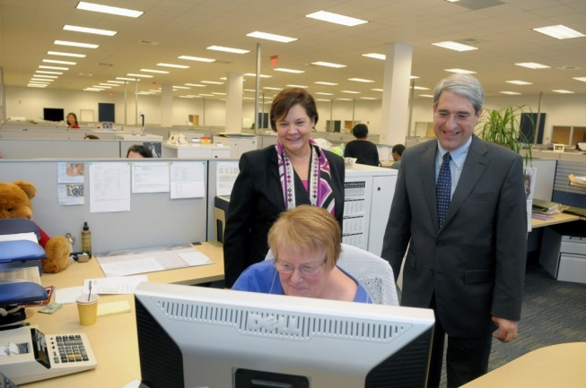
Our Commitment to Departments is to Move through this Carefully, Thoughtfully & in Consultation with Each Department, but Not to Blink!
Do no harm commitment
Learn the details from those who do the best work
Meet with faculty to understand their perspective
Understand & incorporate real differences
Build trust and credibility through interviews, information sharing and pilots
Develop a standard support model, based on best practices, then deploy through training programs and reorganizations
Capitalize on vacancies when possible to implement aspects of the long-term model
Pursue targeted automation to eliminate work and improve access to information
Carefully select, train and oversee staff participating in the new model
Measure workloads and pursue continuous improvement
Notes:
We developed best practices for working with the units based on early experiences.

Slide 33
Differentiating Responsibilities
Regional & Local Support Activities | Shared Services Support Activities
Initiate | Input
Review | Process
Approve | Reconcile
Resolve | Review
Develop | Prepare
Analyze | Support
Integrate | Schedule
Identify
Notes:
There was a lot of confusion in the beginning about what activities would be done where, so we attempted to clarify through the activities that would be expected in shared services vs those that would be housed in the region or the local unit.
Although shared services executes a lot of the transactions, the departments are still accountable for the quality of the business services provided.
They also approve transactions, retain budget accountability, etc.

Slide 34
Institutional Roles & Relationships Faculty Research Management Services
FRMS
Faculty Facing
Pre-Award Proposal Development
Post Award Management & Renewal
*GCA
Proposal Review
Proposal Submission
Signing Authority
Sponsors
Departments and Faculty/PIs
*GCFA
Policies & Procedures
Compliance
Institutional
Oversight
*GCA: Grants and Contracts Administration
**GCFA: Grants and Contracts Financial Administration
Notes:
Compliance issues – is not a one shop operation. Important that this is caught at the beginning.
Joint learning and training opportunities
Leverage both GCA and GCFA training which has already been developed
in the future, could be opportunity for GCA and GCFA to gain experience in the direct faculty support
GCA and GCFA provide institutional oversight, training, subject matter expertise and technology. A collaborative partnership exists between FRMS, GCA and GCFA. FRMS is designed to provide departments of any size and their Principal Investigators with resources and expertise to successfully compete for, manage, and renew sponsored awards
GCA Provides assistance to faculty and staff in obtaining and managing sponsored awards that support scholarly activities while assuring proper stewardship of those funds. The office is charged with review and approval of proposals sent to all sponsors.
GCFA Works closely with FRMS and business office staff to ensure financial compliance and proper accounting of externally sponsored funds. Responsibilities include financial reporting and closeout, effort reporting, and development of the facilities and administrative cost rate.

Slide 35
Institutional Roles & Relationships Yale Shared Services
Department Operations Managers and Other Staff
YSS
Financial Management:
Annual budget process
Monthly budget forecasting and checklist
Credit Card Reconciliations
Transactional Processing:
EMS
Payroll
Vendor Management
Accounts Payable
P-Card Administration
Client Accounts
Finance
Controller
Budget
Audit
Policies
Vendors and other external parties
Procurement
Electronic commerce
Purchasing
Contracting

Slide 36
Current Penetration of Model Components

Slide 37
Status of Anticipated Benefits
Customer Service – Responsive, No Black Holes
Faster Transaction Response/Turnaround Time
Increase in service consistency and accuracy
Improved Decision Support from standardized use of chart of accounts
Client/Faculty
Benefits
Improved Career Path Options-in process
Self-Directed Work Teams
Greater Participation in Decision-Making
Clarity Regarding Expectations
Part of High Performance, High Success Team
Employee Benefits
Financial Benefits
Headcount Related Savings-in process
Non-Labor & Space Savings-in process
Longer-Term, More Leveraged Model of Admin Support-in process

Slide 38
Additional Benefits of Business Services Model
Lead administrators have better information about their metrics and the people in the department that need development.
Enhanced compliance by more broadly leveraging specialists.
Accelerated simplification and standardization of processes as differences are identified in shared service units and regional offices.
Improved relationship with the clerical and technical union.
Decreased level of customization needed in financial and HR applications-in process

Slide 39
Questions?

