Slide 1
TASSCUBO Budget Committee
July 16, 2012

Slide 2
Report Reduction Effort
Alan Werchan

Slide 3
Senate Bill 5 - Zaffirini/Branch
Reduced Unfunded Mandates, Regulations, and State Reporting Requirements

Slide 4
Senate Bill 1179 – Nelson/Harper-Brown
Section 25 – Repeals Specific Report Legislation

Slide 5
Status of On-Going Report Reduction Effort
TASSCUBO Budget Committee
Meeting in May:
Report list has been categorized into reports that should be DELETED, MODIFIED, or KEPT

Slide 6
Status of On-Going Report Reduction Effort
Some reports to consider for revision or deletion are not covered by SB 5 - Require Rider Revisions
Biennial Operating Plan
Limitation on Use of Funds - Personal Residences
State Owned Housing-Recovering Housing Costs
Expenditures for State-Federal Relations
Contract Notifications: Amounts > $50K

Slide 7
Status of On-Going Report Reduction Effort
Some reports to consider for revision or deletion are not covered by SB 5 - Require Rider Revisions
Contract Notification: Amounts >$500K
Method of Financing Scholarships
Community College Transfer Student Reporting Requirement
Reporting Fees, Fines, and Penalties

Slide 8
Status of On-Going Report Reduction Effort
Some reports to consider for revision or deletion are not covered by SB 5 - Require Rider Revisions
Report Concerning Designated Tuition (Part B)
Online Degree Plans
**Recommend including these as Rider 3B Revisions in LARs for 2014-2015**

Slide 9
Status of On-Going Report Reduction Effort
Institutional Representatives will meet with THECB on July 25th
TASSCUBO Budget Committee will continue to work with THECB and Governmental Relations staff to prepare final recommendations on report statuses prior to next legislative session

Slide 10
Contacts
Mary Knight
The University of Texas at Austin
bd.knightme@austin.utexas.edu
512-471-3727
Alan Werchan
The University of Texas System
awerchan@utsystem.edu
512-499-4275

Slide 11
Importance of LAR
Funding will still be tight next session.
LAR is one of the primary communication tools for the institution’s priorities and message.
LAR is key to getting the funding allocation right for each institution.
Formulas provide most of the GR funding.

Slide 12
Changes to the Legislative Appropriations Request (LAR)
Alicia Currin

Slide 13
Recommendations Made by TASSCUBO Budget Committee

Slide 14
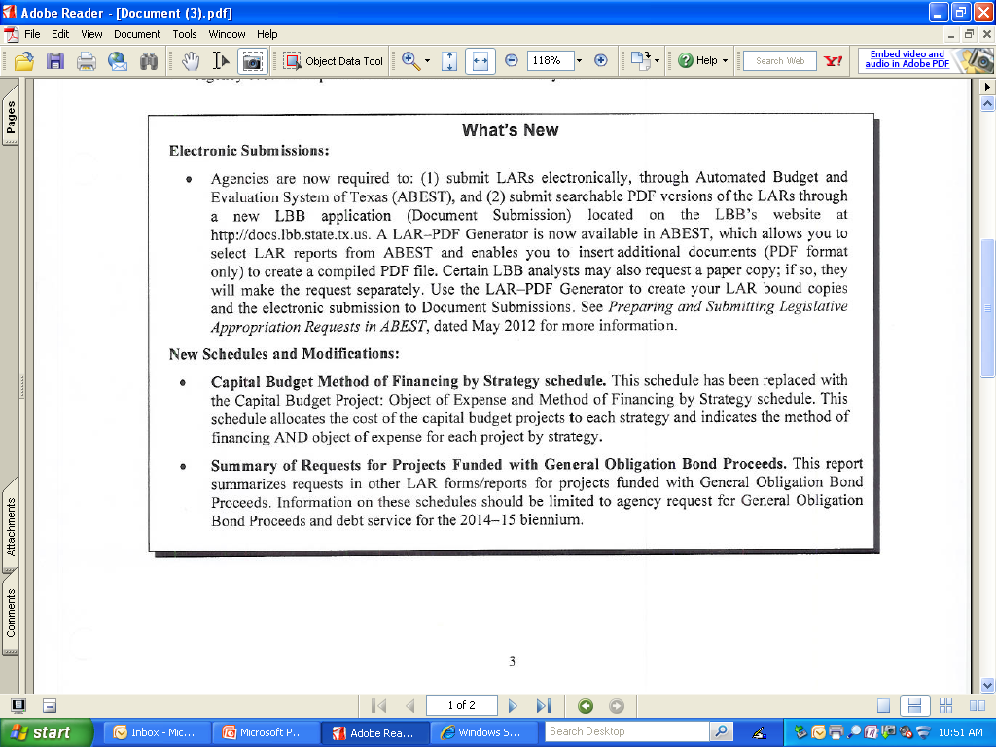
Electronic Submissions & Modifications

Slide 15
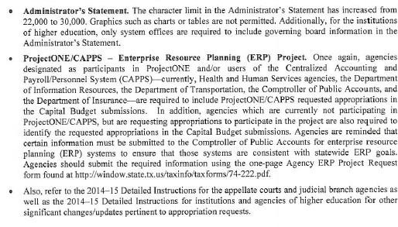
Administrator's Statement & ProjectONE/CAPPS

Slide 16
Submissions
Institutions of Higher Education are not required to submit paper copies of the October LAR submission to the offices listed on page 9 of the 2014-15 Legislative Appropriations Request Detailed Instructions for state unless requested to do so.

Slide 17
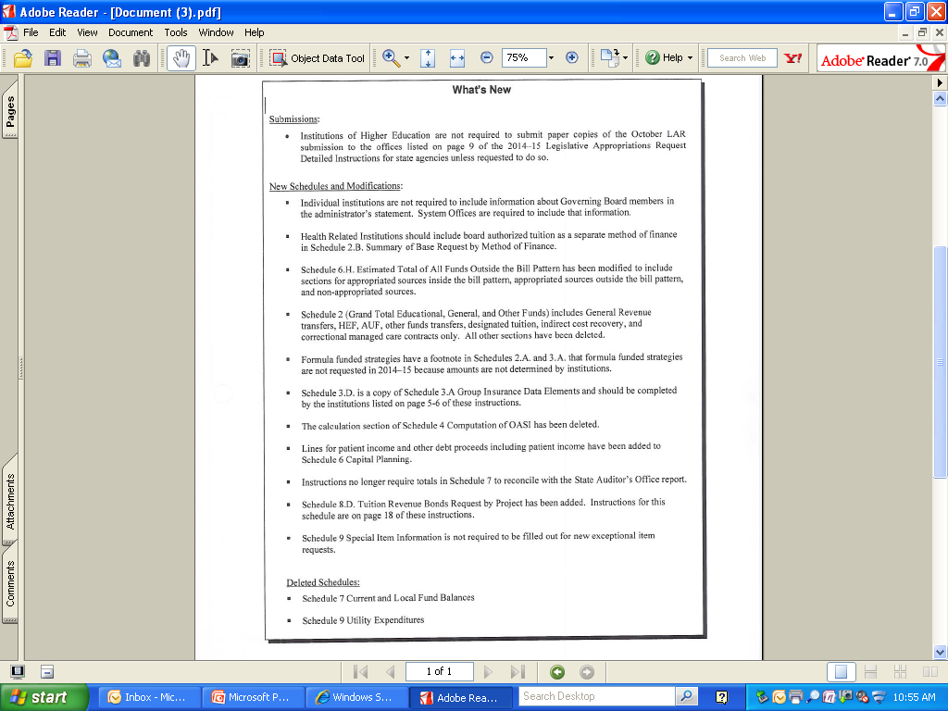
New Schedules & Modifications

Slide 18
Administrator’s Statement
Based on the LAR instructions, Board member information is only required by systems and independent institutions.
Systems and independent institutions should include a statement similar to the following in the Administrator’s statement.
  The Texas Tech University System is governed by a Board of Regents. The current members of the Board of Regents are included in the Organizational Chart.
Eliminate the Board of Regents from the Administrator’s statement and include in the Organizational Chart.

Slide 19
Deleted Schedules
Schedule 7 Current and Local Fund Balances
Schedule 9 Utility Expenditures

Slide 20
Questions
for
Budget Committee Members
or
Sarah Keyton from the LBB

Slide 21
Consistency in LAR Reporting for Higher Education
Alicia Currin

Slide 22
The following consistency standards were agreed upon by the TASSCUBO Budget Committee on May 25, 2012. The intent of these standards is to simplify the LAR process.

Slide 23
Organizational Chart
All institutions would include the chain of command from the Board of Regents to the Vice President level of the institution (i.e., Board of Regents, Chancellor, President, Vice President/Provost). For some Health Related Institutions, Deans would be included if they report directly to the President and not to a Provost.
Positions below a Vice President Level should be excluded.
Detailed Board of Regent information would be provided if required by the institution.
An example of the proposed Organizational Chart changes is attached.

Slide 24
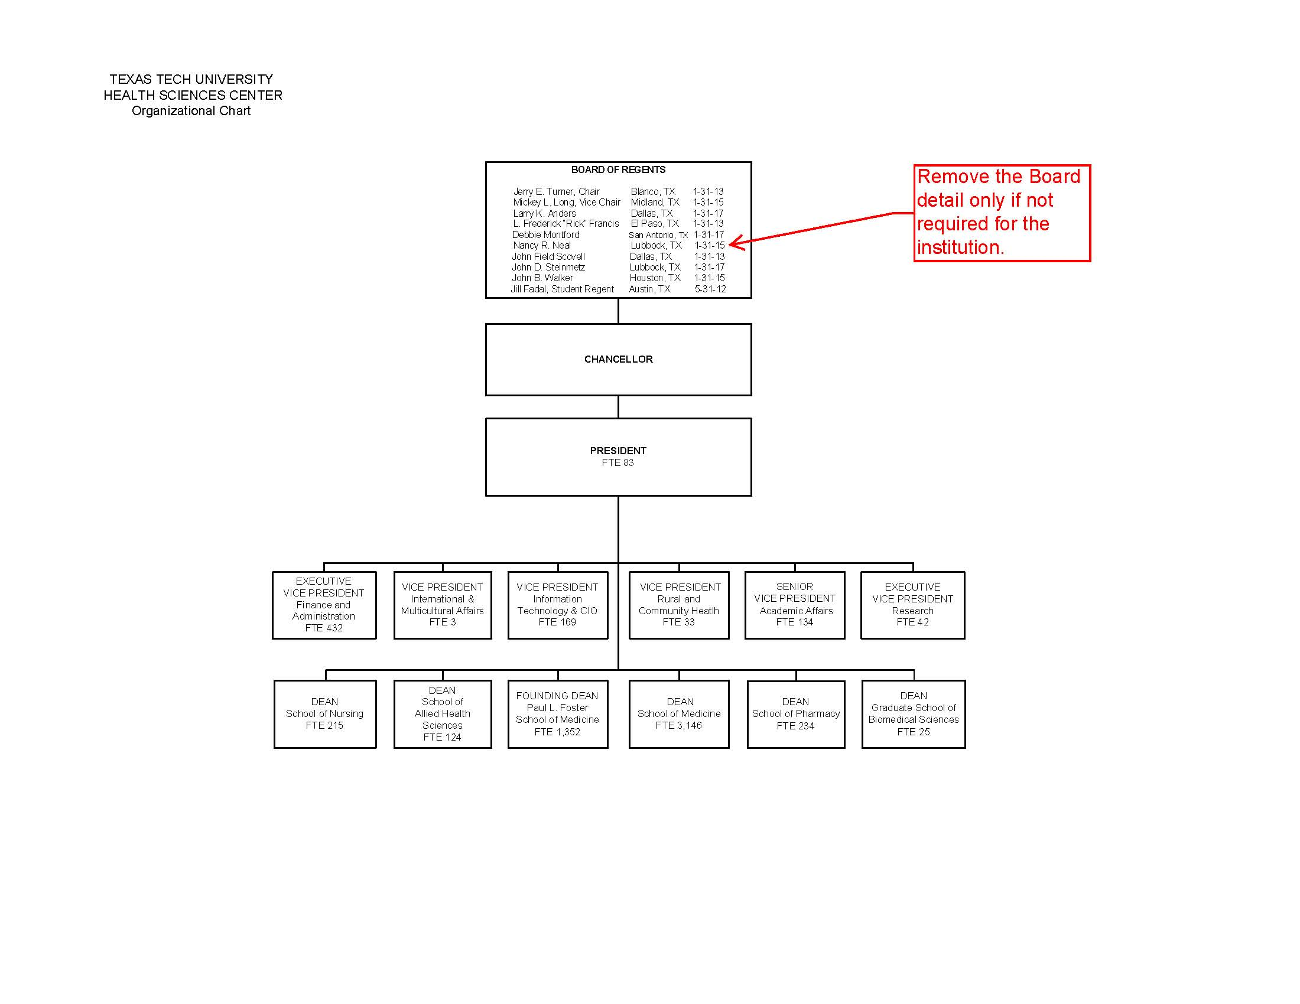
Organizational Chart-1

Slide 25
Schedule 3A Strategy Request-
Formula and Other Common Strategies
The following verbiage should be included in the strategy description and justification section for formula funded and other common strategies. Verbiage should not be included in the Internal/External factors section.

Slide 26
General Academic Institutions-1
Instruction and Operation Formula
The Instruction and Operations Formula provides funding for faculty salaries, departmental operating expense, library, instructional administration, research enhancement, student services and institutional support.
Teaching Experience Supplement
The Teaching Experience Supplement formula provides an additional weight of 10 percent to lower and upper division semester credit hours taught by tenured and tenure-track faculty.
Infrastructure Support
The Infrastructure Support formula distributes funding associated with plant-related formulas and utilities. This formula is driven by the predicted square feet for universities’ educational and general activities produced by the Coordinating Board Space Projection Model.
The portion of the formula related to utilities is adjusted to reflect differences in unit costs for purchased utilities, including electricity, natural gas, water and wastewater, and thermal energy.
The funds are distributed on a weighted semester credit hour basis. The rate per weighted semester credit hour is established by the Legislature each biennium.

Slide 27
General Academic Institutions-2
Research Development Fund
The Research Development Fund is distributed among eligible institutions based on the average amount of restricted research funds expended by each institution per year for the three preceding fiscal years.
Competitive Knowledge Fund
The purpose of the Texas Competitive Knowledge fund is to support faculty for the purpose of instructional excellence and research.
The purpose of these funds is to promote research capacity.

Slide 28
Health Related Institutions -1
Instruction and Operation Formula
The Instruction and Operations Formula provides funding for faculty salaries, departmental operating expense, library, instructional administration, student services and institutional support. (Insert one of the following sentences here based on the strategy.)
The formula for this strategy is based on weighted medical student headcounts.
The formula for this strategy is based on weighted nursing student full time equivalent.
The formula for this strategy is based on weighted biomedical student full time equivalent.
The formula for this strategy is based on weighted dental student headcounts.
The formula for this strategy is based on weighted pharmacy student full time equivalent.
The formula for this strategy is based on weighted public health student full time equivalent.
The formula for this strategy is based on weighted allied health student full time equivalent.
The rate per weighted student headcount or full time equivalent is established by the Legislature each biennium.

Slide 29
Health Related Institutions -2
Infrastructure Support
The Infrastructure Support formula distributes funding associated with plant support and utilities. This formula is driven by the predicted square feet for health related institutions produced by the Coordinating Board Space Projection Model.
Research Enhancement
The Research Enhancement formula allocates $1,412,500 to each institution in addition to 1 percent of the research expenditures as reported to the Texas Higher Education Coordinating Board. These funds are used to support the research activities of the institution.
Because the Space Projection Model does not account for hospital space, separate infrastructure funding for hospital space at The University of Texas Medical Branch at Galveston, the University of Texas M.D. Anderson Cancer Center, and The University of Texas Health Science Center at Tyler shall be included in the total funding for hospital and patient care activities. (This paragraph would only be included for these three institutions).
Graduate Medical Education
The Graduate Medical Education formula allocates funding based on the number of medical residents. These funds shall be used to increase the number of resident slots in the State of Texas as well as faculty costs related to GME.

Slide 30
Health Related Institutions -3
Medical Loans
Section 61.539 of the Texas Education Code requires the 2% of the resident medical school tuition be transferred for repayment of student loans of physicians serving in designated state agencies or economically distressed or rural medically underserved areas of the State.
Permanent Health Fund for Higher Education
This strategy includes the institution’s allocation of the Permanent Health Fund for Higher Education. The purpose of these funds includes medical research, health education or treatment programs.
Other Permanent Health Funds (Education Code, Section 63.101)
Funding for this strategy is derived from annual distributions of Permanent Health Funds established Section 63.101 of the Texas Education Code. These are appropriated for research and other programs that are conducted by the institution and that benefit the public health.

Slide 31
All Institutions
Staff Group Insurance
This strategy is to provide proportional share of staff group insurance premiums paid from Other Educational and General funds.
Worker’s Compensation
The strategy funds the Worker’s Compensation payments related to Educational and General funds.
Texas Public Education Grants
This strategy represents tuition set aside for the Texas Public Education Grants program as required by Section 56.033 of the Texas Education Code.

Slide 32
Schedule 3A- Strategy Request- Special Items
Schedule 9, Special Item Information should be considered the primary schedule for all continuing special item requests.
The mission statement from Schedule 9 should be used as strategy description and justification on Schedules 3A.
In the Internal and External Factors Section, use the following statement:
  Additional information for this strategy is available in Schedule 9, Special Item Information.

Slide 33
Schedule 1A
Other Educational and General Income
Institutions should only include income that meet the definition of Other Educational and General income a defined in the Section 51.009c of the Texas Education Code. Interest Income on Educational and General funds is not specifically defined in this statute but is required on Schedule 1A.
Refunds and Installment Payment Forfeits – Net refunds and installment payment forfeits out of gross tuition and report zero on the Refunds and Installment Payment Forfeits lines.
Institutions are allowed to deduct tuition charged when the institution will not receive formula funding for the student or course. The institution should include 100% of the tuition charged, including the statutory amount in these cases.

Slide 34
Omitted Schedules
A list of Schedules not included in the LAR should be included right after the Table of Contents.
Institutions should no longer insert blank pages for the schedules that are omitted if they are included on this list.
An example is attached.

Slide 35
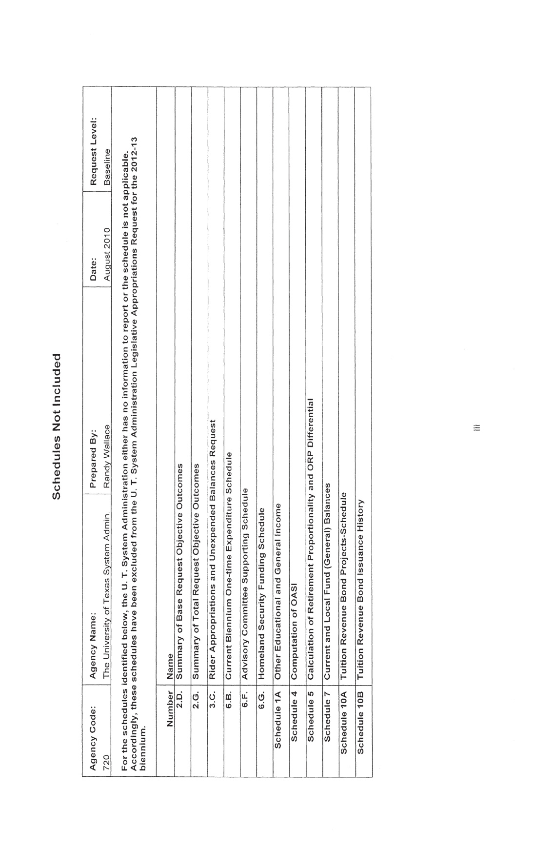
Schedules Not Included

Slide 36
Tuition and Fee Exemptions and Your Institution
Tracy Foster and Bob Piwonka

Slide 37
What are Exemptions?
Exemptions allow special groups of Texas residents to enroll and pay a reduced amount of tuition and fees, or none at all
Most are not funded, which means that the dollars exempted are lost revenue to your institution
Notes:
Some are mandatory, some are optional.
Mandatory are dictated in statute for all institutions to offer
Optional are at the discretion of governing boards
Waivers allow special groups of nonresidents to enroll and pay at resident rates

Slide 38
Why?
To reward individuals or their families for services rendered, or to provide assistance to certain groups of students
In 2009 Texas Exemptions totaled $111 million ($35 million in FY 2003)
Since FY 2003, participation in exemption programs has increased 109%
Notes:
In 2009, 162,267 students received exemptions in Texas
And Texas had 39 exemption programs and $111m is the foregone revenue to institutions for 2009

Slide 39
Exemptions-TAMU
Notes:
Texas Tomorrow Fund Exemptions for 2012 $3,981,137

Slide 40
The Biggest…
The Hazlewood exemption for veterans
  Recently modified to allow veterans who did not use their Hazlewood benefit to pass it on to their children (limited to one child)
Texas Tomorrow Fund & Texas Guaranteed Tuition Plan
  There are large numbers of students in the pipeline and is not expected to peak for another ten or more years
    The impact of the new Texas Promise Fund is expected to be less, but is still an unknown
Notes:
The 2009 legacy provision of the Hazlewood exemption is going to continue to grow in cost. For a veteran to be eligible, they must first use up all federal resources and Hazlewood waives tuition and fees after that. With new increased GI and veterans benefits, veterans can use those resources to pay their way through college and not have to resort to Hazlewood. That leaves Hazlewood available for their children. In many cases veterans will have income that will preclude their children from receiving federal aid, so Hazlewood will kick in right away at a direct cost to the University.
Number of Hazlewood students statewide:
FY 2010: 9,882 FY 2011: 22,583
Cost to Universities:
FY 2010: $24.7M FY 2011: $69.3M

Slide 41
Projected Impact of Hazlewood and Texas Guaranteed Tuition Plan

Slide 42
Projected Impact of Hazlewood

Slide 43
Texas Universities – Hazlewood Impact
Notes:
FY 2012 has 1,109 students at TAMU

Slide 44
Legislative Session and Fiscal Impact Statements
Exemptions are not free
Many times administrators outside of finance do not understand that exemptions cost our students higher fees to recover revenue lost to exemptions
It is important to provide feedback on all new exemptions, but especially new unfunded exemptions
Notes:
Tuition exemptions include designated tuition.

Slide 45
What Can Be Expected
Bills to create new unfunded exemptions
  There are many groups of people who provide service to the state and the country.
    Teachers, military and their families, law enforcement officers, firemen,
  There are others with special needs or circumstances who will also lobby for exemptions
Notes:
Tuition exemptions include designated tuition.
In general, higher education does not take issue with exemptions for these groups, but with the cost to other students, especially low income students if exemptions are not funded.

Slide 46
Questions?
Thank You!
Notes:
Tuition exemptions include designated tuition.

Slide 47
Changes to SAO FTE Reporting
Alicia Currin

Slide 48
Calls from the State Auditor’s Office
Many of you received phone calls from Sandra Vice from the State Auditor’s Office (SAO) related to questions on Higher Education FTEs from the House Appropriations Committee meeting on Tuesday, February 21, 2012.

Slide 49
Questions at the HAC hearing related to higher education FTEs
The largest percentage reduction from FY10 to FY11 was at _____. Why?
For institutions where FTEs decreased, is there any way to determine in higher education if the reduction was in administration or in the classroom?
Said they would have to go back to re-collect the information to provide that and they would have to work with higher education to get a definition that we agreed to.
Would be interested in both instances where there was a reduction in FTEs and an increase in FTEs.

Slide 50
Updates
A few of us from the TASSCUBO Budget Committee met with Sandra via teleconference in March.
The SAO believes we need to report in three distinct categories to answer their questions:
    Faculty, Executive Administration, Non-faculty
She clarified that they are looking at changes from one quarter to the same quarter a year ago.
The SAO made this change effective with the 3rd quarter FTE quarterly report. They were aware that additional programming may be required.
The SAO also added a comment field to allow us to provide explanations for significant changes.

Slide 51
Our Recommendation
Administrators
Removed the reference to the 82nd Legislature to make it more generic. May want to include the specific list of titles instead, but we prefer that the most current definition in the GAA be used for consistency across all institutions.
Proposed Definition: High-ranking administrative positions defined by the General Appropriations Act (Article III, Special Provisions Relating to State Agencies of Higher Education, Administrative Accountability)
Faculty
Including the full IPEDS definition might be confusing since it also references some administrative positions. We recommend the following.
Proposed Definition - Positions with the purpose of conducting instruction, research or public service as a principal activity. Individuals appointed to these positions may hold academic rank titles of professor, associate professor, assistant professor, instructor, lecturer or the equivalent of any of those academic ranks. This does NOT include graduate, instruction or research assistants. If a faculty also serves in an administrator position, the headcount should be prorated based on the hours reported in each category.
Add wording below so that legislators understand there are student positions included in this FTE number.
Other Staff (includes graduate and student assistants) – All other positions not reported as Administrators or Faculty.

Slide 52
Agencies of Higher Education, Section 5-7, General Appropriations Act, 82nd Legislature for a high-ranking administrative position.
“High-ranking administrative position" includes the following positions:
(1) chancellor
(2) vice chancellor
(3) associate chancellor
(4) assistant chancellor
(5) president
(6) vice president
(7) associate vice president
(8) assistant vice president
(9) dean
(10) associate dean
(11) assistant dean
(12) any other administrative position having similar responsibilities to the other positions listed in this subsection.

Slide 53
Administrative Accountability Report
From the majority of the posted Administrative Accountability reports ,
  http://www.lbb.state.tx.us/Administrative_Accountability_Reports/General_Academics_Institutions.html
There are 6 institutions that report the Athletic Director: ASU, Tarleton, Texas Southern, Texas State (also has a VP title), UNT, and Lamar University. Lamar reports head coaches and the chairs of all the academic depts.
UTSA was the only one that reported the Chief of Police.
There were a few institutions that reported “Director positions,” but the vast majority of institutions followed the track of the list below.

Slide 54
They accepted the TASSCUBO Budget Committee recommendation with the following change:
“We've decided to go ahead and be specific about the GAA because we do not want to have what is being measured to change from biennium to biennium.”

Slide 55
Other Items for Discussion
HB 1781 Obsolete or Redundant Reporting Requirement – due August 1, 2012
  If you do not have unique reports, do not submit the blank template to all of the offices. Instead, send an email to nanette.pfiester@tsl.state.tx.us with that information. She is concerned that all of the offices will have to take time to open the “blank” templates. She does not plan to follow up if the excel template is not received and will maintain a list of those who reported “no unique reports.”

Slide 56
Other Items for Discussion
Cost Efficiencies Survey – due August 1, 2012
Online Degree Plans Survey – due August 1, 2012
LAR Checklist from UT

Slide 57
Federal Updates
Subsidized Student Loan Interest Rate Hike Staved Off for at Least One More Year
  Congress passed legislation to keep the interest rate on subsidized Stafford student loans from doubling to 6.8 percent, but only after weeks of negotiations and just two days before the increase was due to take effect.
Deadline Extended for Campuses to Sign VA’s “Principles of Excellence” for Serving Veterans and Service Members
  The Department of Veterans Affairs (VA) notified campuses that the deadline to express intent to comply with the "Principles of Excellence for Educational Institutions Serving Service Members, Veterans, Spouses, and Other Family Members" has been extended from June 30 to Aug. 1.

Slide 58
Federal Updates
House Votes to Repeal State Authorization, Credit Hour Regulations
The House of Representatives voted 303-114 to repeal the Department of Education’s (ED) state authorization and credit hour regulations that went into effect July 1, 2011

Slide 59
Questions

