Slide 1
Texas Demographic Characteristics and Trends
Texas Association of State Senior College and University Business Officers
July 16, 2012
Conroe, Texas
Notes:
Lloyd Potter is the Texas State Demographer and the Director of the Texas State Data Center based at the University of Texas at San Antonio.

Slide 2
Growing States, 2000-2010
 | 2000 Population* | 2010 Population* | Numerical Change 2000-2010 | Percent Change 2000-2010
United States | 281,421,906 | 308,745,538 | 27,323,632 | 9.7%
Texas | 20,851,820 | 25,145,561 | 4,293,741 | 20.6%
California | 33,871,648 | 37,253,956 | 3,382,308 | 10.0%
Florida | 15,982,378 | 18,801,310 | 2,818,932 | 17.6%
Georgia | 8,186,453 | 9,687,653 | 1,501,200 | 18.3%
North Carolina | 8,049,313 | 9,535,483 | 1,486,170 | 18.5%
Arizona | 5,130,632 | 6,392,017 | 1,261,385 | 24.6%
Population values are decennial census counts for April 1 for 2000 and 2010.
Source: U.S. Census Bureau. 2000 and 2010 Census Count.
Notes:
Texas is the second largest state in terms of population (2nd to CA) and area (2nd to AK). In terms of number of people, Texas’ growth exceeds that of all other states between 2000 and 2010.

Slide 3
Total Population and Components of Population Change in Texas, 1950-2011
Percent Change Due to
Year* | Population | Numerical Change | Percent Change | Natural Increase | Net Migration
1950 | 7,711,194 | -- | -- | -- | --
1960 | 9,579,677 | 1,868,483 | 24.2 | 93.91 | 6.09
1970 | 11,196,730 | 1,617,053 | 16.9 | 86.74 | 13.26
1980 | 14,229,191 | 3,032,461 | 27.1 | 41.58 | 58.42
1990 | 16,986,510 | 2,757,319 | 19.9 | 65.85 | 34.15
2000 | 20,851,820 | 3,865,310 | 22.8 | 49.65 | 50.35
2009 | 24,782,302 | 3,930,484 | 18.8 | 54.04 | 45.33
2010 | 25,145,561 | 4,293,741 | 20.6
2011 | 25,674,681 | 529,120 | 2.1 | 54.79 | 44.99
* All values for the decennial dates are for April 1st of the indicated census year. Values for 2009 and 2011 are for July 1 as estimated by the U.S. Census Bureau. Source: Derived from U.S. Census Bureau Estimates for dates indicated by the Texas State Data Center, University of Texas at San Antonio. Note: Residual values are not presented in this table.
Notes:
The components of change include natural increase (births-deaths) and net migration (in-out migration). In recent years, natural increase and net migration have contributed almost equally to Texas’ growth. Natural increase is much more predictable and stable than net migration. Net migration tends to fluctuate with economic factors.

Slide 4
The 10 Fastest Growing Metro Areas from April 1, 2010, to July 1, 2011
 |  | Percent Increase
1. | Kennewick-Pasco-Richland, Wash. | 4.3
2. | Austin-Round Rock-San Marcos, Texas | 3.9
3. | Hinesville-Fort Stewart, Ga. | 3.4
4. | McAllen-Edinburg-Mission, Texas | 3.0
5. | Raleigh-Cary, N.C. | 2.9
6. | Warner Robins, Ga. | 2.9
7. | Provo-Orem, Utah | 2.7
8. | Charleston-North Charleston-Summerville, S.C. | 2.6
9. | Myrtle Beach-North Myrtle Beach-Conway, S.C. | 2.6
10. | Yuma, Ariz. | 2.6
Source: U.S. Census Bureau, 2012

Slide 5
The 10 Metro Areas with the Largest Numeric Increase from April 1, 2010, to July 1, 2011
 |  | Numeric Increase
1. | Dallas-Fort Worth-Arlington, Texas | 154,774
2. | Houston-Sugar Land-Baytown, Texas | 139,699
3. | Washington-Arlington-Alexandria, D.C.-Va.-Md.-W.Va. | 121,911
4. | New York-Northern New Jersey-Long Island, N.Y.-N.J.-Pa. | 118,791
5. | Los Angeles-Long Beach-Santa Ana, Calif. | 115,964
6. | Miami-Fort Lauderdale-Pompano Beach, Fla. | 105,490
7. | Atlanta-Sandy Springs-Marietta, Ga. | 90,345
8. | Riverside-San Bernardino-Ontario, Calif. | 80,146
9. | Phoenix-Mesa-Glendale, Ariz. | 70,349
10. | Austin-Round Rock-San Marcos, Texas | 67,230
Source: U.S. Census Bureau, 2012

Slide 6
The 10 Counties with the Largest Numeric Increase from April 1, 2010, to July 1, 2011
 |  | Numeric Increase
1. | Harris, Texas | 88,452
2. | Los Angeles, Calif. | 70,451
3. | Maricopa, Ariz. | 63,127
4. | Miami-Dade, Fla. | 58,331
5. | Riverside, Calif. | 49,979
6. | Dallas, Texas | 47,875
7. | Orange, Calif. | 45,513
8. | San Diego, Calif. | 44,756
9. | Bexar, Texas | 41,376
10. | Tarrant, Texas | 40,776
Texas contains eight of the 25 counties with the highest numerical gains
Source: U.S. Census Bureau, 2012

Slide 7
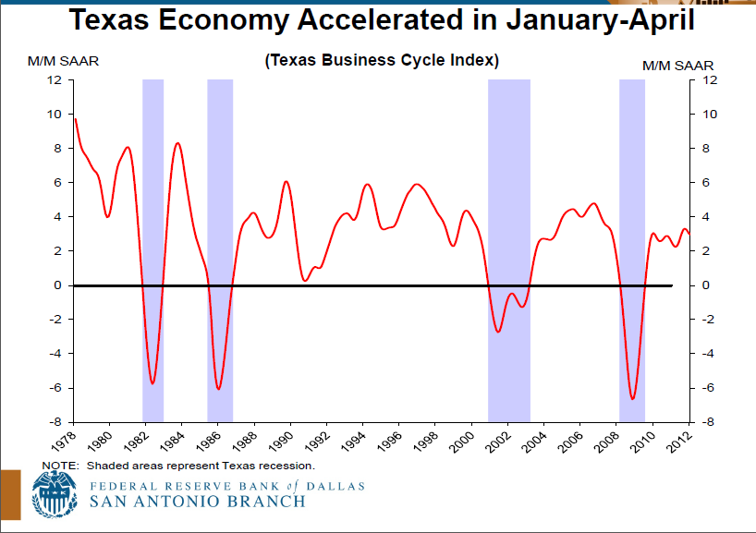
Texas Business-Cycle Index
Notes:
Texas has experienced several recessions in the past, the most recent was the most significant.

Slide 8
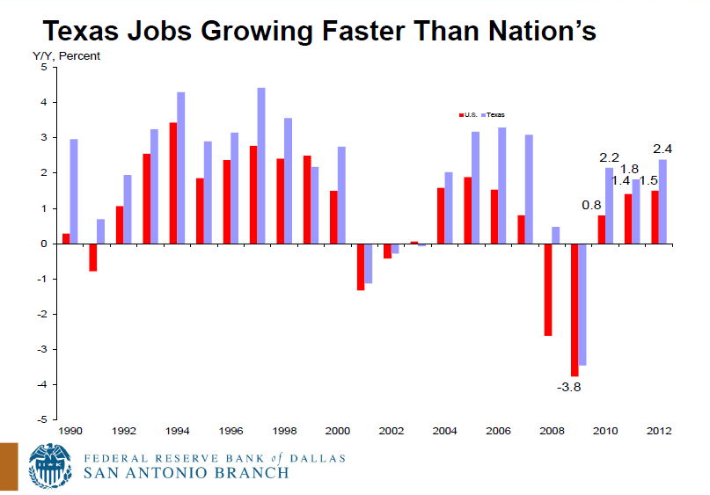
Texas Jobs Growing Faster Than Nation’s

Slide 9
Estimated Annual Net Migration to Texas, 2000 to 2009
Hurricane Katrina
Source: U.S. Bureau of the Census 2009 Estimates
Notes:
Migration into Texas has made very significant contributions to our population growth for the past few decades. International migration is estimated to have made significant contributions this decade. Generally, international migration is regulated and tends not to vary substantially from year to year. Internal (state-to-state) migration is estimated to have increased significantly in the middle of this decade and has remained relatively high. This peak in 2005-2006 was also fueled by significant migration from Louisiana post hurricane Katrina. However, with the economic downturn, internal migration into Texas is likely slowed. Internal migration is not regulated by the government and is largely driven by the presence or absence of jobs and economic opportunity. Therefore, internal migration tends to be variable and dependent upon economic fluctuations.

Slide 10
Percent of Migrants to Texas between 2000 and 2009 by Race and Ethnicity
52% of all migrants were international
(848,702 migrants )
(933,083 migrants)
Sources: Percentages of domestic and international migrants by race and ethnicity derived from the 2006-2008 American Community Survey. Total numbers of domestic and international migrants between 2000-2009 are from Table 4. Cumulative Estimates of the Components of Resident Population Change for the United States, Regions, States, and Puerto Rico: April 1, 2000 to July 1, 2009, U.S. Census Bureau
Notes:
More than half of migrants to Texas over much of the past decade were international migrants. About two-thirds of Texas migrants were members of racial and ethnic minority groups over much of the decade.

Slide 11
States with Largest Estimated
Unauthorized Immigrant Populations, 2010
State | Estimate (thousands) | Range
California | 2,550 | (2,350 - 2,750)
Texas | 1,650 | (1,450 - 1,850)
Florida | 825 | (725 - 950)
New York | 625 | (525 - 725)
New Jersey | 550 | (425 - 650)
Illinois | 525 | (425 - 625)
Georgia | 425 | (300 - 550)
Arizona | 400 | (275 - 500)
6.5% of Texas’ 2010 Population
Source: Pew Hispanic Center estimates based on residual methodology applied to March Supplements to the Current Population Survey (February 1, 2011).
Notes:
Texas has an estimated 1.65 million unauthorized immigrants. Assuming most unauthorized migrants were counted in the Census, this represents about 6.5% of the total population.

Slide 12
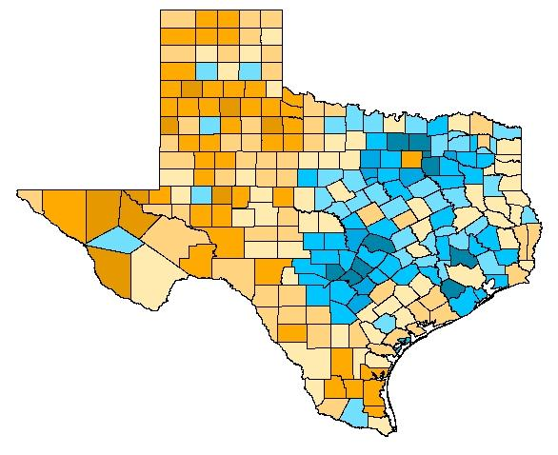
Estimated domestic migration (2000-2008) by county as a percentage of 2000 population
Source: Population Division, U.S. Census Bureau, March 19, 2009. Map produced by the Texas State Data Center
Notes:
This map demonstrates DOMESTIC, or internal, migration made up largely of persons who are citizens or legal residents of the United States. International migrants are not included on this map. Generally, western counties had U.S. residents and citizens moving out and the areas around urban cores had U.S. residents and citizens moving in. Note that Dallas and Harris county have net out domestic migration indicating that persons from these counties may be moving to more suburban adjacent counties.

Slide 13
Estimated international migration (2000-2008) by county as a percentage of 2000 population
Source: Population Division, U.S. Census Bureau, March 19, 2009. Map produced by the Texas State Data Center
Notes:
This map demonstrates in migration of international migrants. Domestic migrants are not included on this map. It is estimated that international migrants made significant contributions to population growth in large urban counties and along the border. Note that Dallas and Harris counties experienced substantial international migration resulting in a positive net in-migration to those counties.

Slide 14
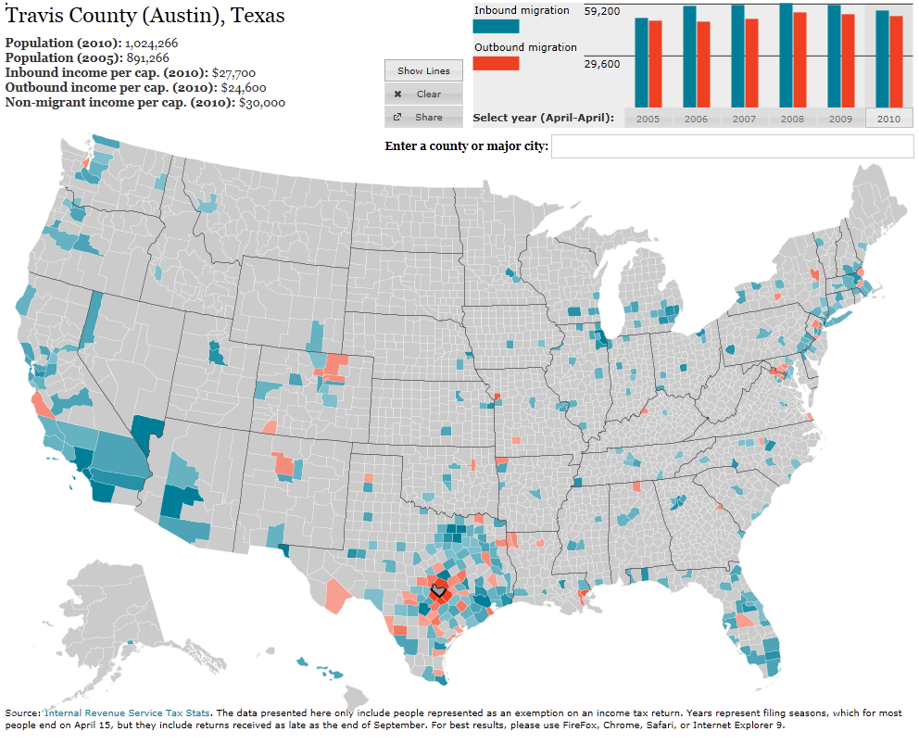
http://www.forbes.com/special-report/2011/migration.html
Notes:
This map from Forbes.com (www.forbes.com/special-report/2011/migration.html) illustrates migration flows for the selected county.

Slide 15
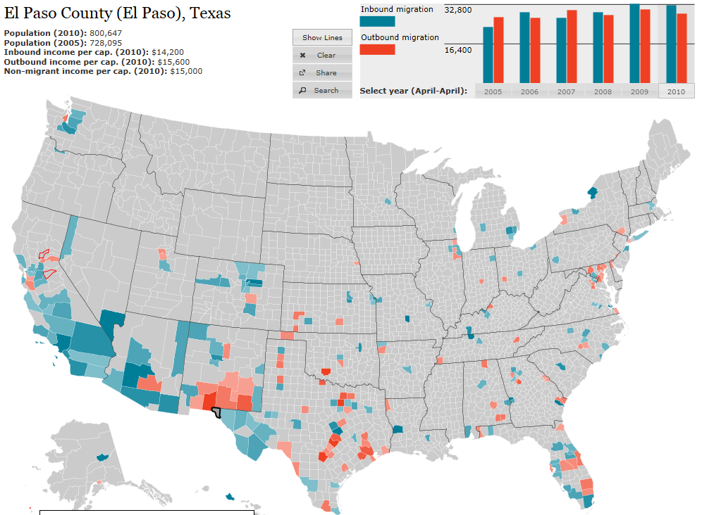
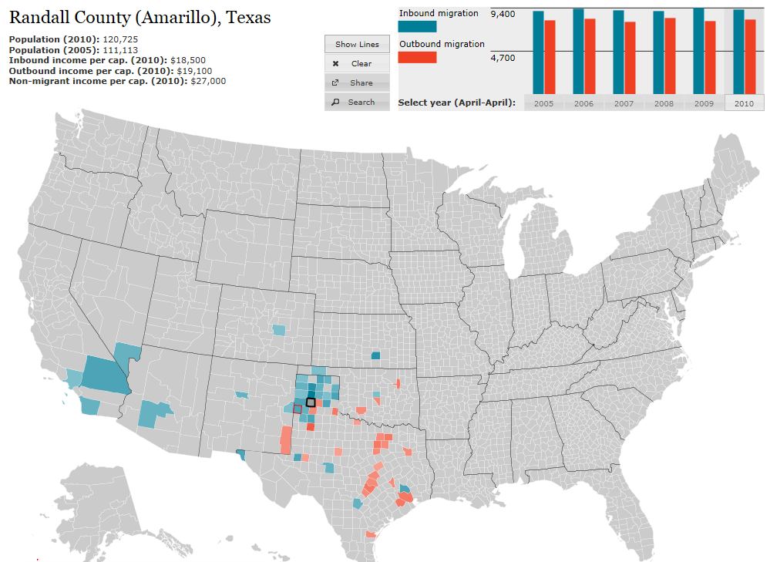
http://www.forbes.com/special-report/2011/migration.html
Notes:
This map from Forbes.com (www.forbes.com/special-report/2011/migration.html) illustrates migration flows for the selected county.

Slide 16
Texas Racial and Ethnic Composition,
2000 and 2010
Source: U.S. Census Bureau. 2000 and 2010 Census count
Notes:
As of the 2000 Census, about 53% of Texas’ population was non-Hispanic Anglo, about 32% where of Hispanic descent, about 11% where non-Hispanic African American, and about 4% were non-Hispanic Other.
In 2010, it is estimated that about 45% of the Texas population was non-Hispanic Anglo, 38% of Hispanic descent, 11% were non-Hispanic African American, and about 6% were non-Hispanic Other (largely of Asian descent).

Slide 17
Texas White (non-Hispanic) and Hispanic Populations by Age, 2010
Source: U.S. Census Bureau 2010 Decennial Census, SF1
Notes:
The age distribution of the non-Hispanic white population in Texas is weighted heavily with the “baby boom” generation. Largely the result of lower fertility and less net in-migration, the non-Hispanic white population has relatively fewer young persons relative to those in the middle-age years. In 2010, at ages 37 and younger, the Hispanic population exceeds the non-Hispanic white population.

Slide 18
Texas Population Pyramid by Race/Ethnicity, 2010
Source: U.S. Census Bureau 2010 Decennial Census, SF1
Notes:
This population pyramid represents the age, sex, race and ethnic composition of the Texas population. Blue represents males, red females, rows are single years of age, and shades represent specified race/ethnic groups as indicated in the legend.

Slide 19
Texas Population Pyramid by Race/Ethnicity, 2010
Source: U.S. Census Bureau 2010 Decennial Census, SF1
Notes:
This population pyramid represents the age, sex, race and ethnic composition of the Texas population. Blue represents males, red females, rows are single years of age, and shades represent specified race/ethnic groups as indicated in the legend.

Slide 20
Texas Population Pyramid by Race/Ethnicity, 2010
Source: U.S. Census Bureau 2010 Decennial Census, SF1
Notes:
This population pyramid represents the age and sex composition of the Texas non-Hispanic white population. Blue represents males, red females, rows are single years of age.

Slide 21
Texas Population Pyramid by Race/Ethnicity, 2010
Source: U.S. Census Bureau 2010 Decennial Census, SF1
Notes:
This population pyramid represents the age, and sex composition of the minority population in Texas. Blue represents males, red females, rows are single years of age, and shades represent specified race/ethnic groups as indicated in the legend.

Slide 22
Total Population by County, 2010
Source: U.S. Census Bureau 2010 Census Counts
Notes:
The counties of Harris, Bexar, Dallas, Tarrant, and Travis are the most populated in the State. Collin, Denton, Fort Bend, Hidalgo, and El Paso counties also have significant population concentrations. Many counties west of Interstate 35 are more sparsely populated.

Slide 23
Change of the Total Population by County, 2000 to 2010
79 counties lost population over the decade
Source: U.S. Census Bureau 2000 and 2010 Census Counts
Notes:
175 counties gained population while 79 lost population over the decade.

Slide 24
Percent of the Population Less than 18 Years of Age, Living Under Poverty for During Past 12 Months, 2005-2009
Source: U.S. Census Bureau, American Community Survey, 5-Year Sample 2005-2009

Slide 25
Median Household Income by County, 2005-2009
Source: U.S. Census Bureau, American Community Survey, 5-Year Sample 2005-2009

Slide 26
Percent of the population 5 and over who speak English less than very well by state, 2009
Source: American Community Survey, 2009

Slide 27
Percent of the population 5 and over who speak Spanish at home, 2009
Source: American Community Survey, 2009

Slide 28
Percent of the population 5 and over who speak Spanish at home, 2005-2009
Source: U.S. Census Bureau, American Community Survey, 5-Year Sample 2005-2009

Slide 29
Percent of population that is foreign born, 2005-2009
Source: U.S. Census Bureau, American Community Survey, 5-Year Sample 2005-2009

Slide 30
Percent of Households that are Linguistically Isolated, by County, 2005-2009
Source: U.S. Census Bureau, American Community Survey, 5-Year Sample 2005-2009

Slide 31
Percent of population aged 25 years and older with high school or equivalent degree or higher 2005-2009
Source: U.S. Census Bureau, American Community Survey, 5-Year Sample 2005-2009

Slide 32
Percent of population aged 25 years and older with Bachelors degree or higher. 2005-2009
Source: U.S. Census Bureau, American Community Survey, 5-Year Sample 2005-2009

Slide 33
Educational Attainment in Texas, 2010
Level of Educational Attainment | Percent of persons aged 25 years and older | State Ranking
High school diploma or equivalency or greater | 80.7% | 49/50 (tied with CA)
Bachelors or greater | 25.9% | 31
Source: U.S. Census Bureau, American Community Survey, 2010.

Slide 34
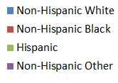
Race/Ethnic Composition by Education Level aged 25 years and more, Texas, 2009
College and Greater
Less Than High School
Source: Derived from 2009 American Community Survey 1-Year Estimates by the Office of the State Demographer.

Slide 35
Educational attainment by place of birth, persons aged 25 years or more, Texas, 2010
Source: U.S. Census Bureau, American Community Survey, 2010.

Slide 36
One Year Persistence Rate of First-Time Entering Undergraduates by Parent's Educational Level Public University in Texas, 2010
Percent of student’s enrolling in second year
Parent’s educational attainment
Source: Texas Higher Education Coordinating Board

Slide 37
Projected Percent of Labor Force by Education Attainment in Texas, 2000 and 2040
Source: Texas State Data Center. 2008 Population Projections, 1.0 Migration Scenario.
Notes:
tc 6.1 -- 12-4-02 308

Slide 38
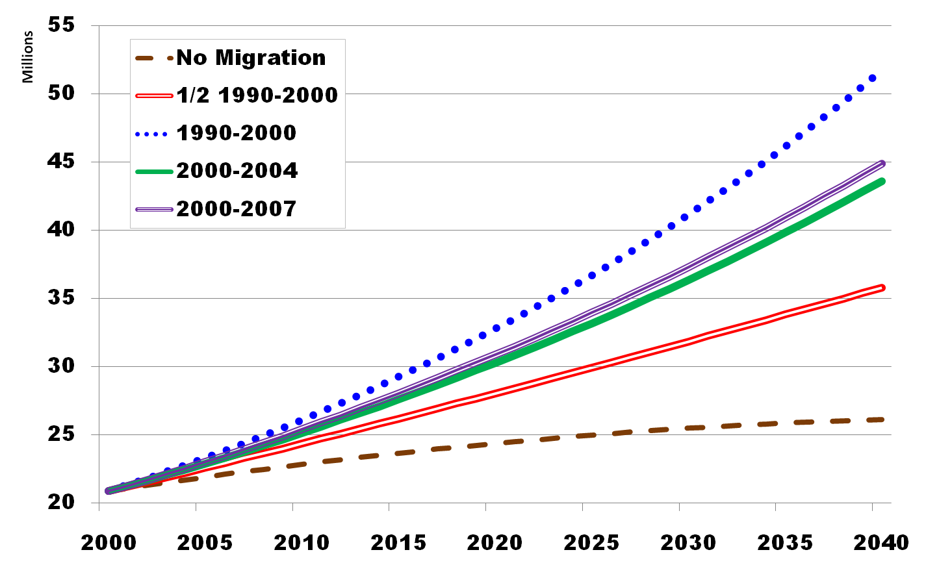
Projected Population Growth in Texas, 2000-2040
8-9 million?
7 million?
5 million?
Year
Source: Texas State Data Center 2008 Population Projections
Notes:
This graph represents variable population projections for the State under different migration scenarios. The base (brown dashed line) is the assumption of no migration. Under this scenario, the State will grow as a function of natural increase (births-deaths). The ½ 1990-2000 scenario (the red split line) is the most conservative. The 2000-2004 and 2000-2007 scenarios reflect estimates of migration for those two periods and suggest more rapid population growth. Under any scenario, even no migration, Texas will continue to grow.

Slide 39
Projected Racial and Ethnic Percent, Texas, 2000-2040
Source: Texas State Data Center 2008 Population Projections , 2000-2007 Migration Scenario
Notes:
The 2000-2007 migration scenario is likely the most realistic to consider in short term projections. Using this scenario, the number of Hispanics will likely exceed the number of non-Hispanic Anglos in the State around 2015.

Slide 40
Contact
  Office: (512) 463-8390 or (210) 458-6530
  Email: Lloyd.Potter@osd.state.tx.us
  Internet: http://osd.state.tx.us
Lloyd Potter, Ph.D., M.P.H.
Notes:
The Office of the State Demographer and the Texas State Data Center are committed to supporting your work through providing you with the best, most accurate, and objective information we can identify about our greatest asset, the people of Texas.

